Slide 1
How Different European Countries are Managing the Interface between Science, Society and Politics
Tore Tennøe
Director, The Norwegian Board of Technology
Dublin 8 May 2012

Slide 2
Parliamentary technology assessment in Norway
Public and independent body since 1999
Addresses the Stortinget “and other authorities”
Assessing opportunities AND consequences
No orders: The Board initiates its own projects
Initiating public debate
Extensive use of international network of TA

Slide 3
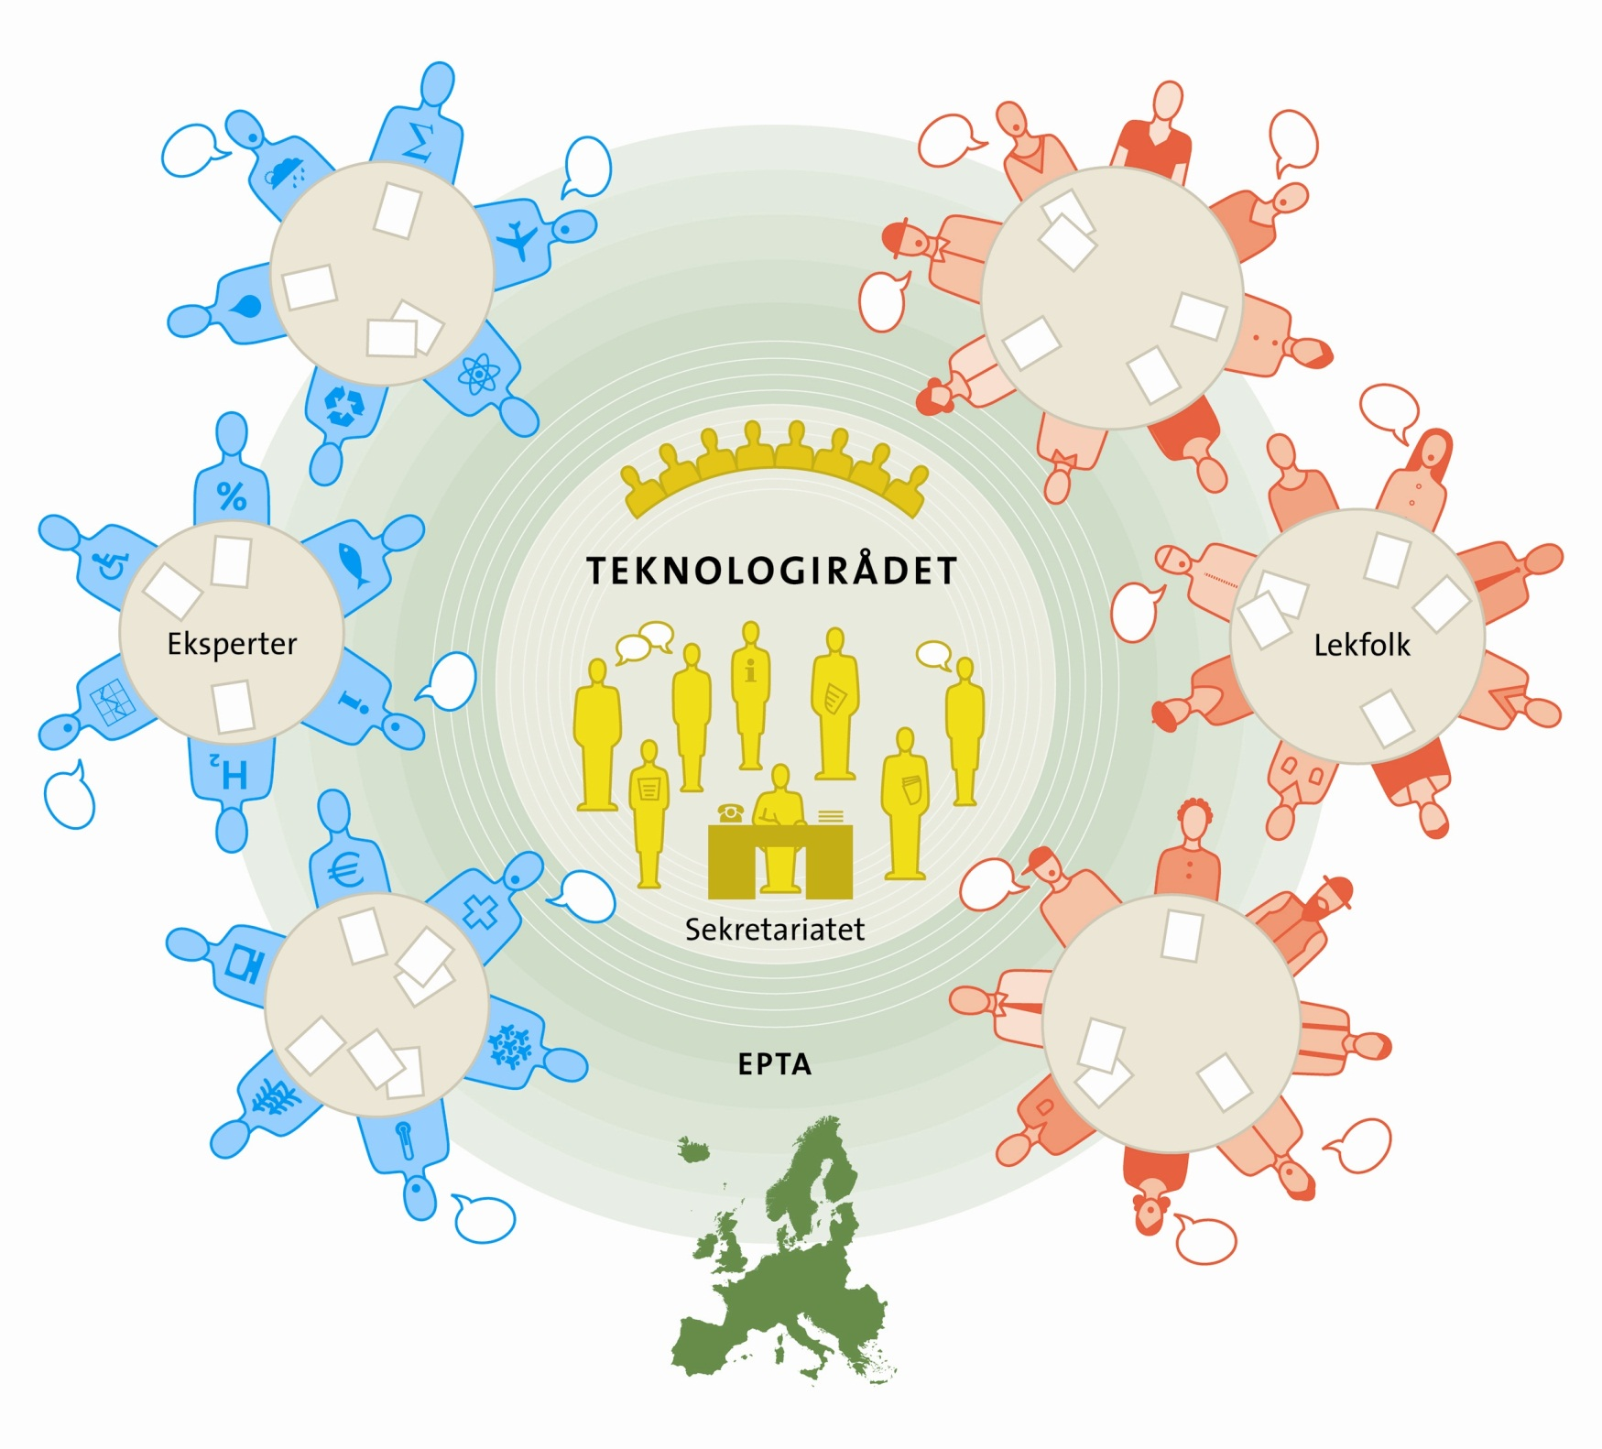

Slide 4
Notes:
Sekratariatet 8 ansatte, 50/50 samfunnsvitenskap og teknologi
Ekspertgrupper – sammensatt, hybride forum i seg selv
Lekfolk

Slide 5
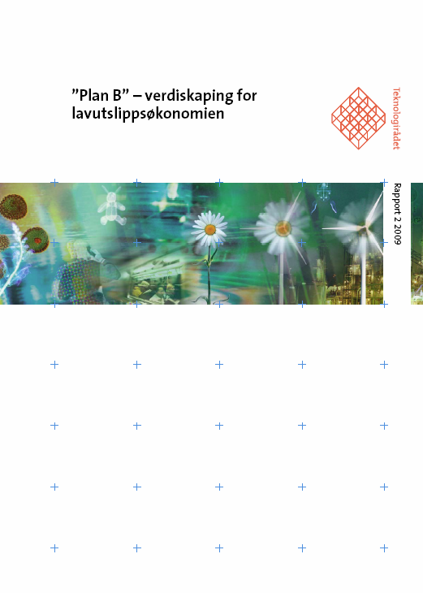
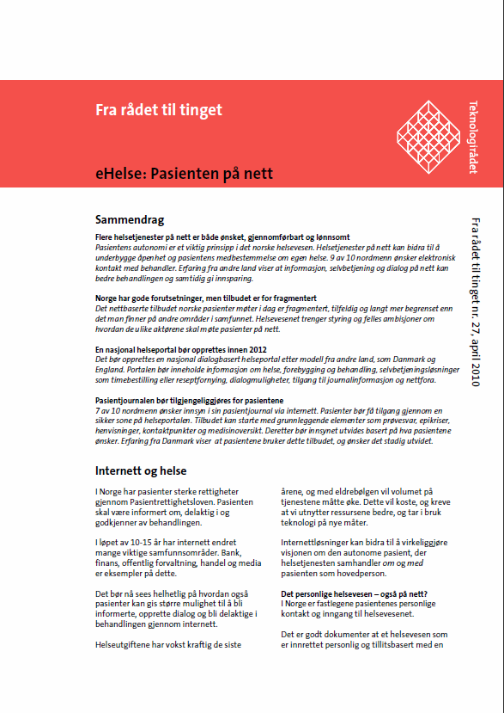
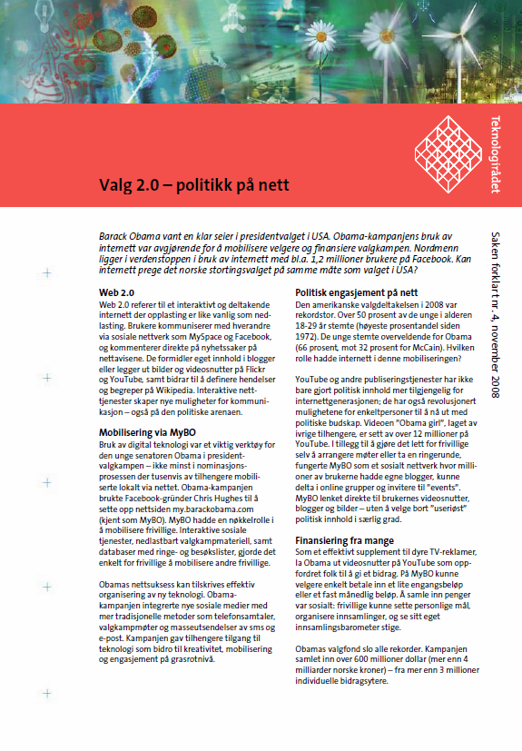
Notes:
Ulike formater – tilpasset lesere

Slide 6
Making TA – some key elements
What is the relation to parliament?
What is the main purpose?
How is the input produced?

Slide 7
Parliamentary committees
Inside Parliament
FR
GR
IT
FI
SE
EP
UK
CAT
Inform Parliament and
and stimulate societal debate
Inform Parliament
CH
FL
DE
USA
NO
NL
Parliamentary
offices/units
DK
AT
Independent institutes
Outside Parliament

Slide 8
FL
Independent organisations
AT
CH
NL
NO
DK
DE
Parliamentary
office
EP
USA
SE
UK
CAT
FI
Parliamentary committee
GR
FR
IT
Primarily
experts
Experts and stakeholders
Experts, stakeholders and society at large

Slide 9
Different modes of work
Contributing to the agenda:
Timing
Dialogue with fractions and groups
Policy briefs
Hearings in the Stortinget
Setting the agenda
Communicating results directly
Interpellations, propositions
Through the government
Through the media
Radar: Early detection
Scientific breakthroughs
Foresight
Notes:
Time pressure
Stakeholders and lobbyists
We are recognized as independent and competent, but need to get heard every time
Agenda setting: How to
→ new MPs, different committees

Slide 10
Dilemmas
Independence vs funding
Freedom, but no automatic recipients
Visibility vs neutrality?
Usefulness at parliament vs “hairy” projects
Broad vs narrow mandate: Are we experts?
Always: Transparency and impartiality

Slide 11
How to Engage Politicians, Scientists, and Citizens to Drive More Effective Policy Making
Jon Fixdal, Norwegian Board of Technology

Slide 12
The role of the NBT
Politics
Expertise
The public
Stakeholders
Notes:
Teknologirådet som formidlende institusjon: Arenabygger, rådgiver (stortinget) og fasilitator
Ulike prosjekter har ulikt tyngdepunkt
Lekfolkskonferanse om stamceller eller ekspertgruppe om programvarepolitikk
Her: Forskjellige grupper representert

Slide 13
Three main methods
Expert groups: State of the art knowledge
Software; Fish Farming; Car Taxation; Carbon fund
Not only scientists are experts
Stakeholder dialogue: Reality check – the interests at stake
Road Traffic; Tourism; Sustainable innovation;
Citizen involvement: Reality check – the values at stake
WWViews; Stem cells and cloning, GM foods, eGovernment
Often a combination of process elements

Slide 14
An example: The future of fish farming
Fall 2010: Board decides to run project
March 2011: Start-up conference
April 2011: Recruiting expert group
May - December 2011: 7 expert group meetings
October 2011: Public hearing
April 2012: Report finished
May 2012: Presentation in Parliament

Slide 15
More on fish farming
In the expert group:
Fish farmers
NGOs
A supplier of fish farming technologies
Scientific experts
Representative from an oil and gas construction company
No one holds «the truth»
Intense debates
Consensus not a must – but interesting if possible

Slide 16
Some thoughts on public participation
Numerous participatory methods have been developed
Cases
The deep: Consensus conferences
The short (but multinational): Interview meetings
The wide: Citizen summits
No doubt: It can be done!

Slide 17
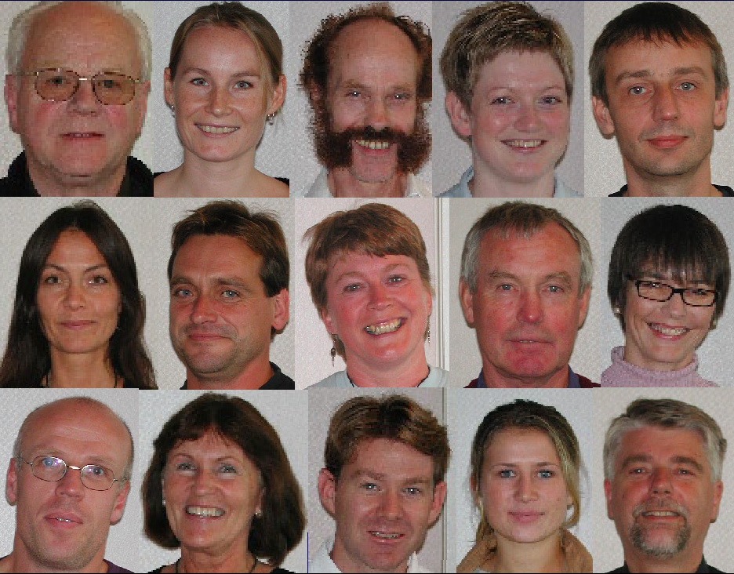
Notes:
2000 randomly selected Norwegian citizens invited >100 replied positively > a diverse group of 16
2 preparation weekends: choosing questions
and experts: Stem cell scientists, theologian, ethicist, NGOs, Bu also: patient, politician, Biomed CEO,
Final weekend with questioning and writing recommendations

Slide 18
Notes:
’America Speaks’: Citizen Summits for byen Washington D.C.
Mayor Anthony Williams har i sine to valgperioder planlagt byens prioriterede budget med ca. 3-4.000 borgere
indenfor uddannelse, sundhedsvæsen, lov og orden, og politisk vision for byens fremtid.

Slide 19
Key challenges and questions
The question of representativity
The possibility for manipulation
The need for transparency
The need for unbiased facilitation – who are the organizers?
What happens when the process is over?
Who takes responsibility for dissemination of results?
What status should the advice have?
Too expensive?

Slide 20
Participation = more effective policy making?
Can lead to better informed and more democratic decision making
A supplement/an additional voice to other policy advice
Not on all projects
Role of organizers is crucial
For the legitimacy of the process
For the linkage to decision makers
Policy makers should feel some ownership to process

Slide 21
A typical foresight story?
Globalisation & knowledge society
My field is going to play a key role
It will help the climate AND foster innovation
More money to research is needed
Much more!
+ information to the public, science in schools, a dash of ethics etc.
Zzzzzzzz….

Slide 22
Making foresight
Specific motivation: Matching societal needs and tech development
Involvement of stakeholders, but not all the time
Focus on decisions that must be made now (backcasting)
Early contact with recipients
Deliberate choice of methods: Scenarios, forecasting, roadmapping

Slide 23
The future of ageing
Scenarios for 2020
Academics and stakeholders
Mix: Demographics and tech base, but focus on organising principle
3 persons, three scenarios
No «favourite» scenario
Notes:
Ekspertgruppe og scenarieverksteder

Slide 24
Workshop
3 cities
Experts and stakeholders
Assessing and voting
Media communication
Next phase: Expert group makes own report
Presentation to parliament
100 + intros

Slide 25
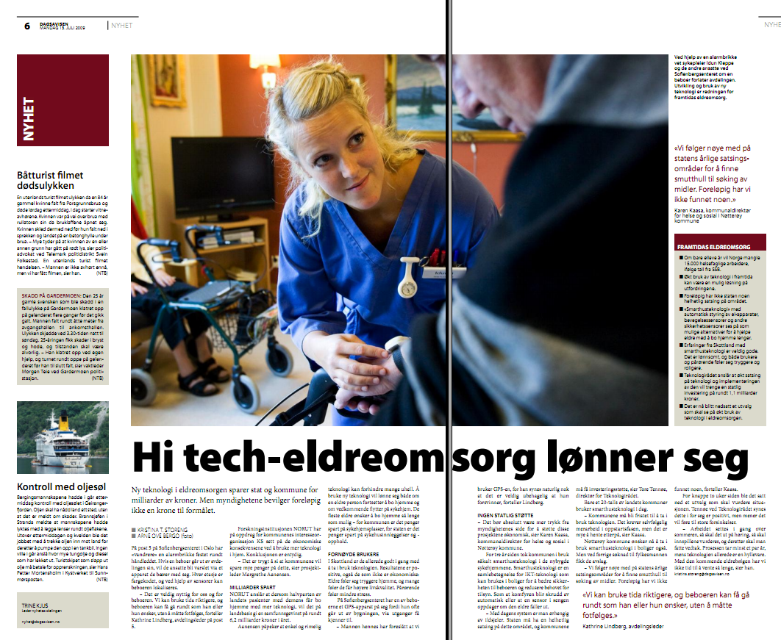
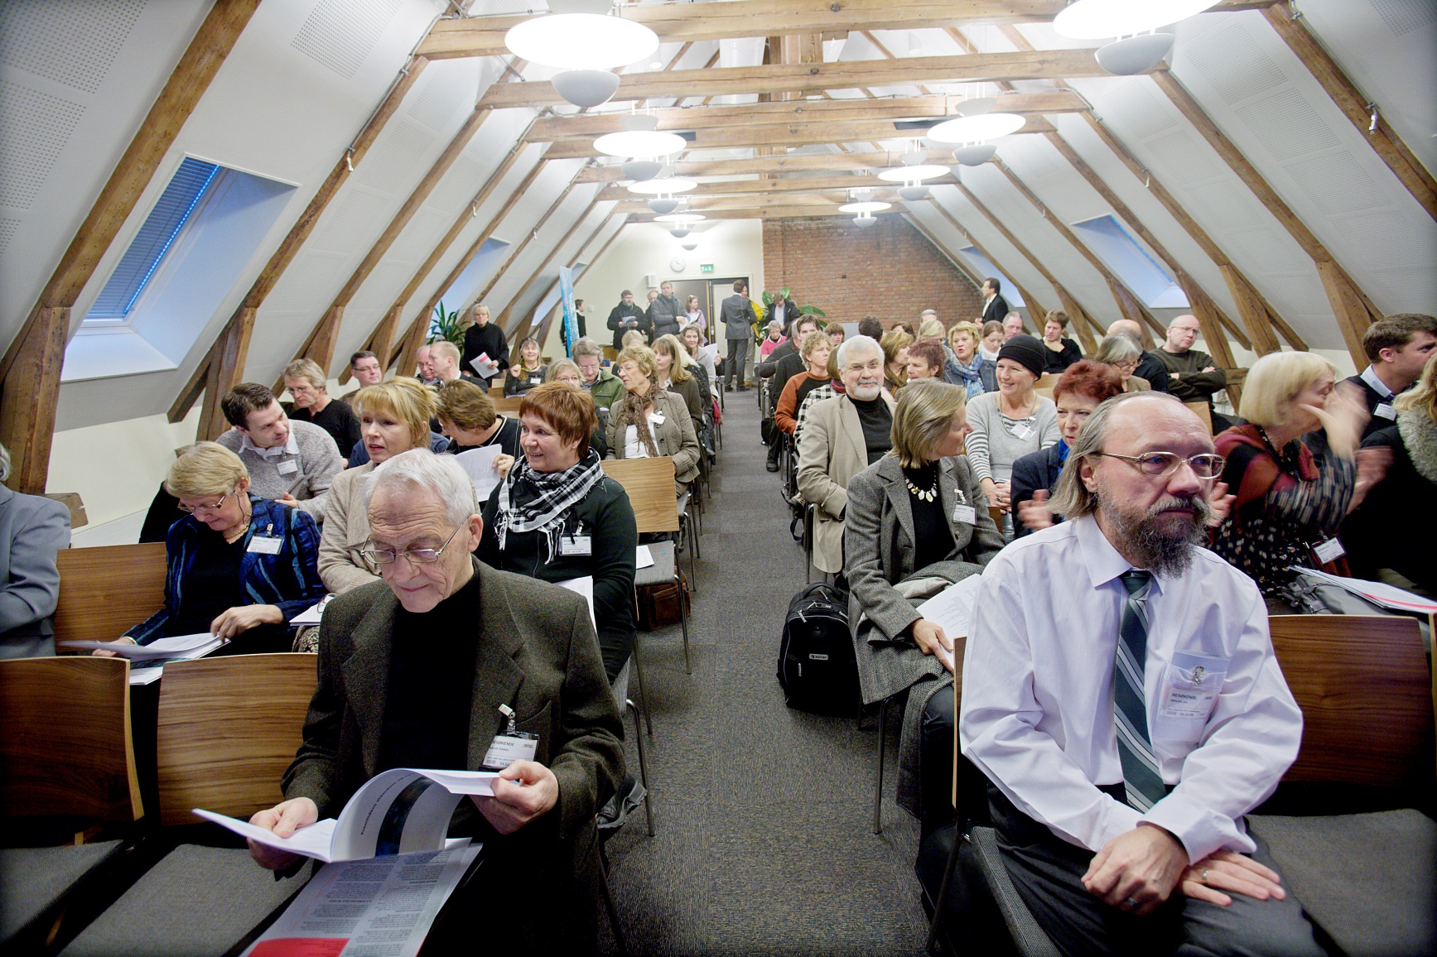
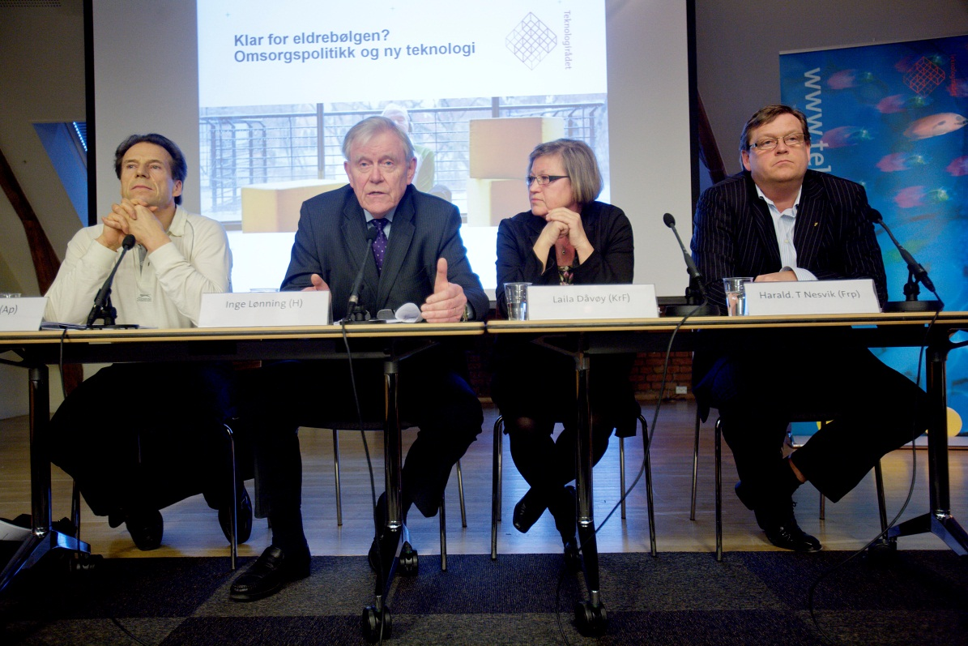
Notes:
Lansering på Stortinget – debatt med politikere
Åpent møte – politikere, interessenter, næring, privatpersoner
Debatt i media

