Slide 1
Overview of TA like
activities in Lithuania
Dr. Edgaras Leichteris
Knowledge Economy Forum,

Slide 2
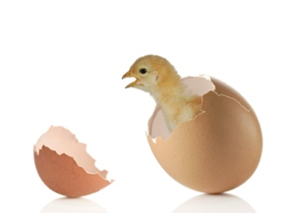
The role of the “birth enabler”
Or how we have started

Slide 3
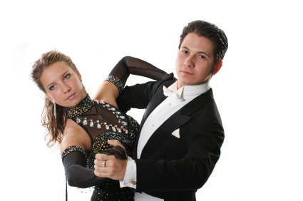
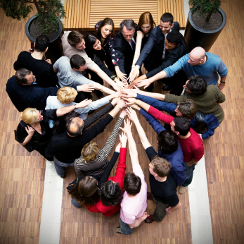
Interviews in Switzerland
Or how we have learned a lot

Slide 4
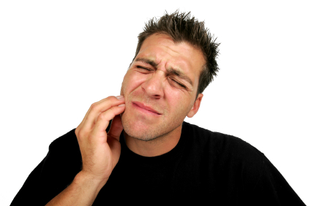
Interviews in Lithuania
... So what is the TA (after 5th explanation) ?

Slide 5
Strengths and Weaknesses
It’s much easier to talk about problems in our S&T system and Innovation scoreboard
Science and education reform
Big SF projects (valleys, etc.)
Highly educated, but often without skills and competences
Effectiveness of funding (good signs, but still a lot of problems)

Slide 6
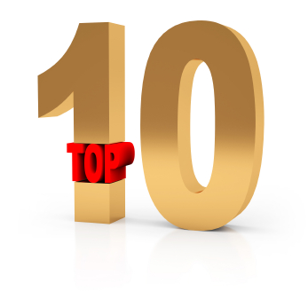
Main issues
From the analysis of strengths and weaknesses
Demand for high quality research in general (“tired of imitation”)
Unrecognized demand by politicians
Political decisions are based on anecdotal examples or opinions (not research/advice)
You need to be well prepared, sometimes you need to change coalition in parliament for “1 hour” to make the decision

Slide 7
Organisations
Many players, many ambitions, weak capacities
Parliament vs Government
Agencies (MITA, MOSTA, etc.)
Research Council vs Science Academy
Scientific and Business communities
NGO’s/ Citizens / General public

Slide 8
TA like activities
We have some very fragmented experience
Risk assessment – we have, but not in the PTA context
Environmental impact assessment – best what we have, but in low quantities
Philosophy of technology and ethics – the worst preparation for that
Social studies – only few scientists capable
Technology foresight – none.

Slide 9
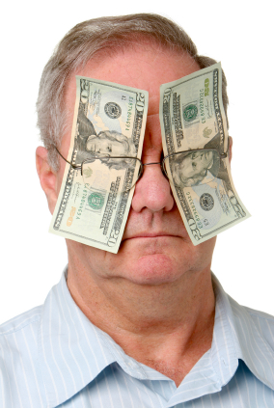
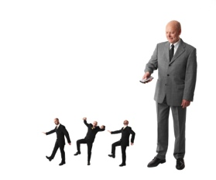
So do we need it ?
YES, .... BUT
“Not as always”
“Not for the money”
“Not in a hurry”
“Not with this Parliament”
“Only if it’s independent”

Slide 10
How to position it ?
“Stay away from society”
Position it towards politics or research
… but “If the society is not involved, politicians will not listen”
And
Research vs Debates/Advice
Winner: for good advice you need good debates, based on some research

Slide 11
Future
Slow “food for thought” and a lot of learning
Identify interests of key players - NOW
Prepare some possible scenarios (research model, public debate model, parliamentary institution, independent, private, tenders vs budget) – July or September
Some experiments by Knowledge Economy Forum in 2012-2013 to show how it looks like
Pilot project in 2014 by somebody (Lithuanian SF)

