Slide 1
Parliamentary TA in Europe
The example of the Office of Technology Assessment at the German Parliament
Dr. Leonhard Hennen
Institute of Technology Assessment and Systems Analysis, Karlsruhe Institute of Technology (ITAS / KIT)
European Technology Assessment Group
PACITA Workshop, Vilnius, 25th of May 2012

Slide 2
Science and Society
The more it becomes clear that Science and Technology are the central resource of social welfare, the more they become a subject of policy making
Impacts and effects of technology on environment and society are a permanent subject of political and social debate
Governments take over responsibilities for promoting R&D and thus are held to be responsible for ensuring a socially and environmentally sound implementation of technology

Slide 3
Why TA? – problems of policy making in the field of Science and Technology
Legitimisation: lacking consensus on what is a socially acceptable application of technologies
Democratic inclusion: growing demands of social groups (those afflicted) to be involved in decision making
Democratic Control of R&D: politics is lacking access to relevant knowledge

Slide 4
Why TA? – problems of decision making
Complexity of decision making: there is no one best solution to a problem, different values and interests have to be taken into account
New Uncertainties:
Science induces new questions without being able to give definite answers:
How safe is safe enough?
What is a socially acceptable distribution of risks and benefits?
Is R&D in line with our cultural beliefs and values (ethics)?

Slide 5
What is TA?
Assessment of possible (future) effects of new scientific and technological developments on human health, society, economy and the environment.
Facts
TA: Intermediate between Science and Politics
Values

Slide 6
Two models of Technology Assessment
The “Pre-TA”, positivistic (or technocratic) model of decision making: Policy making is informed (guided) by Science to a one best solution of the problem at stake
Reflexive Modernization: Cognitive uncertainties and normative ambiguities are unavoidable
TA as an answer to the crisis of the technocratic Model
Policy Analysis Model
Expand the scientific knowledge
base of decision making by employing different scientific perspectives and disciplines
Take account of different values and interests
Deliberative Model
Expand the normative basis of decision making by involving different social perspectives, interests and values
Deliberate on best ways of problem solving

Slide 7
Intermediate Role of TA
Politics
Public
TA
Science

Slide 8
www.eptanetwork.org
Founded in 1991
Full-members: 14 Parliamentary TA institutes in Europe (3 associate members)
Cooperative network, no formal legal entity (consortium)
Continuous exchange on projects and methods
Activities:
Annual conference and directors meeting
Project data base
Joint projects: Privacy, Biotechnology
Cooperation in EU funded projects on TA concepts and methods (EUROPTA, TAMI)
Bi-annually: Project managers meeting

Slide 9
www.eptanetwork.org
Politics Parliament
“Committee model”
Greece
Italy
France
Finland
European Parliament
“Interactive model”
“Office model”
Flanders
Germany
Switzerland
United Kingdom
Netherlands
Denmark
Norway
Austria
Public Debate
Catalonia
Science

Slide 10
Technology fields covered by EPTA projects 1990-2009 Total of 587 projects covered by EPTA database: www.eptanetwork.org

Slide 11
Büro für Technikfolgen-Abschätzung beim Deutschen Bundestag
www.tab-beim-bundestag.de
discussion on TA in the Bundestag since 1973
institutionalisation of TAB by law in 1989
main idea: contract of the German Bundestag on the operation of TAB with an external organisation
duration of contracts: five years (after pilot phase 1990–1993)
since 1990 operation of TAB by ITAS (Institute for Technology Assessment and Systems Analysis) which is part of Forschungszentrum Karlsruhe
since 2003 institutionalised cooperation with FhG-ISI
annual budget 2 Mio. Euro, including budget for subcontracting and external expertises

Slide 12
Model of Institutionalisation
German Parliament
Committees
Steering Committee Committee for Education, Research and TA
Parl. Rapporteurs for TA
TAB
Scientific Unit
Extern. Scientific Institution ITAS Research Center Karlsruhe (Fraunhofer ISI)
Public
Science

Slide 13
Mission
Advising the German Bundestag by
analyzing the potentials of new scientific and technological developments and exploring the associated opportunities
examining the framework conditions of new scientific and technological developments
analysing their potential impacts in a comprehensive forecast
developing alternative options for action possibly to be taken by parliamentary decision-makers

Slide 14
Types of Activities
TA-Projects
Explore potentials of scientific and technological development
Analysis of legal, economic and social conditions for implementation of innovations
Comprehensive analysis of impacts
Develop alternative options for shaping of technology development and implementation
Monitoring
Observation of trends in S&T and of related societal developments
Concepts and Methods of TA
Contribute to the scientific discussion on TA (its goals, mission, methods, function and performance)
Policy Benchmarking, Future Reports, Innovation Reports

Slide 15
Selected recent and ongoing Projects
Hazards and vulnerability in modern societies – the case of a large-scale outage in the electricity supply
Pharmacological and technical interventions for improving performance: perspectives of a more widespread use in medicine and daily life (»enhancement«)
Renewable energy sources to secure the base load in electricity supply – contribution, perspectives, investments
International competitiveness of the European economy with regard to the EU state aid policy: the case of nanoelectronics
Clinical research in Germany with special focus on non-commercial studies
Regulations for access to the information society
Future potentials and strategies of traditional industries in Germany – impacts on competitiveness and employment
How can research contribute to solving the problem of world food supply?

Slide 16
Tool Box
Expert and Science based Approach
Technology Forecast
Scenario Writing
Eco-Balances
Economic Modeling
Feasibility Studies
Surveys, Focus Groups, Interviews
Communicative Instruments
Workshops
Mutual Comments on Expert Opinions
Public Committee meetings

Slide 17
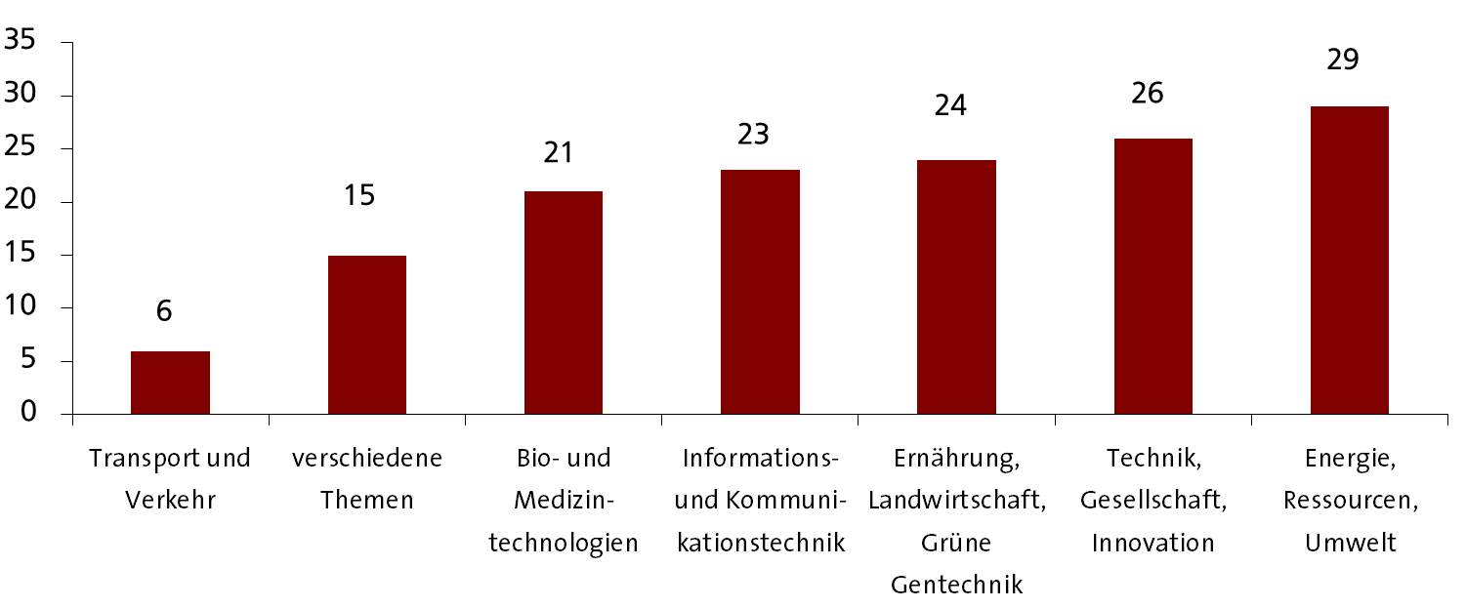
Thematic focus of TAB reports (1991 – 2009)

Slide 18
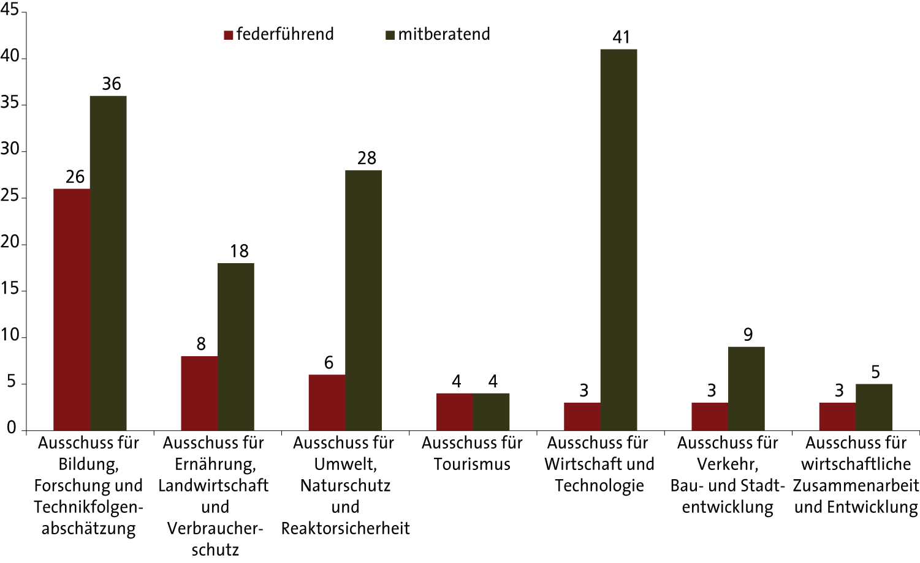
Parliamentary committees concerned with TAB studies (1991 – 2009)

Slide 19
Working Procedures
Pre-project phase
Definition of subject by parliamentary committees
Project outline by the scientific unit
Decision on project by steering committee (prepared by group of rapporteurs for TA) Consensus Principle

Slide 20
Working Procedures
Project phase (scientific unit) (Duration: one up to two years)
Further clarification of questions to be analysed (together with rapporteurs of the committee that initialised the project)
Collection of information (subcontracts with external experts, stakeholder and expert workshops, interviews, desktop research)
Report on results and outline of policy making options
Comments by rapporteurs and experts
Approval of report by committee and publication
Post project phase
Dissemination of results by scientific unit
Approval by Steering Committee
Parliamentary consultation

Slide 21
Formal treatment of reports in parliament
Approval of report by Research Committee and Committee responsible for the project
Decision on publication of report as an official “printed matter” of the parliament (Research Committee)
“First reading” in plenary (formal)
Consultation of the report in committees asked for opinion
Recommendation for policy conclusions by responsible committee and Research Committee
Plenary debate and final decision

Slide 22
How do MPs make use of TAB reports?
Ulla Burchardt, chairwoman of the Committee for Education, Research and Technology Assessment:
“If parliamentarians want to take decisions independently and to the best of their knowledge, they need normative orientation and a well-founded knowledge base. The studies of TAB contribute substantially in this respect. In my everyday work I use results of TAB projects for speeches, for preparing myself for panel discussions and debates, but also as a source when preparing parliamentary motions and bills.”

Slide 23
Utilisation of TAB reports
Background-knowledge
Legitimisation of policies
Support and initialisation of parliamentary activities
Influencing policy formulation (governmental R&D programs)
Filter of policy options (decision making)

Slide 24
Resonance of selected TAB projects (evaluation report an TA at the Bundestag, 2010)
Possibilities for geothermal electricity generation in Germany“ (2003) : Results taken up by Social Democrats and the Green party to formulate a motion
Taken up in parliamentary debate together with the new bill on renewable energy
Nanotechnology (2003): report on a broad range of policy aspects taken up by all parliamentary groups to start motions
Research projects and programmes started by the government in the following years clearly inspired by the TAB report
MPs in a debate on the state of the art of Nanotechnology in Germany in 2007 referred to the important role of the report for orienting policies on Nano
Military use of space and possibilities for arms control in space (2004):
basis for a plenary debate on “space politics” in 2004. Members of the parliament supported their arguments by referring to the TAB report: “Weapons have no place in space. The TAB report makes clear how important it is to position oneself clearly in this regard.”
“Public electronic petitions and civil participation” (2009): major effect in the federal an the state parliaments. TAB was invited to a meeting of the chairmen of petititon committees of the federal and the state levels Special issue of the “Zeitschrift für Parlamentsfragen” on electronic petitioning.
“2nd and 3rd generation of green genetic engineering (2010)”: results presented in a public committee meeting in 2010. Additional public expert meeting was organised.
Controversial discussion of the report’s rather sceptical assessments in parliament and among interest groups,
German Society of Biologists: “the report opened up an opportunity to come back to a sober and factual discussion on the potentials for application and on security aspects of green biotech”
Third report of the federal government on experience with the German law on genetic engineering quoted extensively from the recommendations given in the TAB report

Slide 25
Benefits and problems of the TAB model
Benefits
Clear division of competences between politics and science
Information tailored according to the needs of parliament
Access to TA capacities not restricted to one committee
In-depth and non-partisan analysis of policy making problems
Problems
Relatively weak links with public discourse, relatively low public visibility
Restricted time resources for parliamentary debate on TA-reports
Contradictory political demands (in-depth analysis and quick results)

Slide 26
Thank you very much!
leonhard.hennen@kit.edu

