Slide 1
PACITA Workshop, Vilnius, 25.5.2012
Example on the use of TA for solving complex policy issues: transition of the German Energy system
Jens Schippl
ITAS, KIT

Slide 2
Energy systems and TA
Energy systems are crucial for economies growth and the quality of life
Different targets: energy system has to be
  Environmental friendly
  Reliable
  Affordable (economical efficient)
Generation, distribution and consumption of energy has various intended unintended effects
Uncertainty > are high shares in renewable energy possible?
Different views in society on how the energy system should look like and on how this should be achieved
Complexity + Ambiguity > Knowledge of different sources is needed to anticipate and assess developments in energy systems
General problem of integrating interdisciplinary knowledge
General problem of integrating different societal views and perspectives
> TA offers an integrative perspective in a evidence-based manner

Slide 3

Motivations for the German energy transition
Climate Change
Nuclear phase-out
Energy security
Competitive advantages (lead markets)

Slide 4
The German Energy Concept
Long-term perspective –time horizon 2050
High Shares in renewable energy envisioned
Renewables in power generation
  Nowadays 20%
  Target 2020: 35%
  Target 2050: 80%
Primary energy consumption: should be reduced (ref 2008)
  by 20% in 2020
  By 50% in 2050
Since Fukushima: nuclear phase-out until 2022

Slide 5
Energy efficiency and energy consumption until 2010

Slide 6
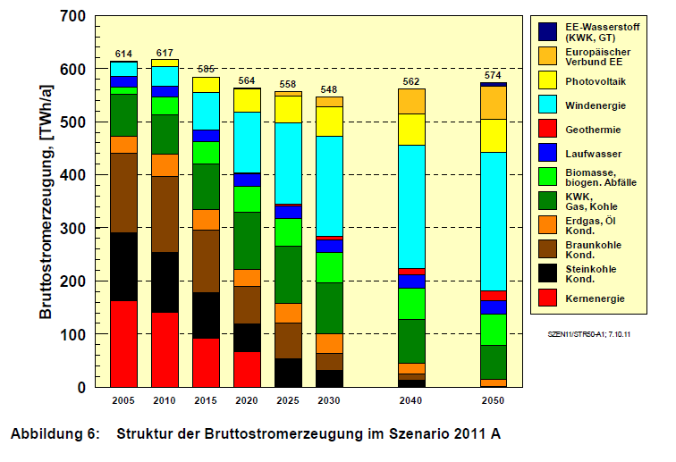
Scenario for power generation in 2050
Source: DLR Leitstudie 2011

Slide 7
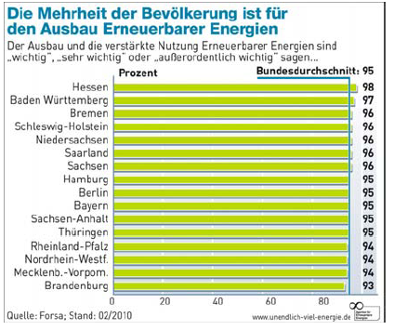
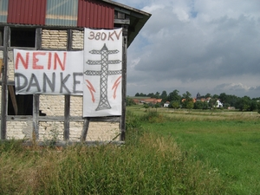
Public acceptance of the energy transition
TNS Emnid in Nov. 2011: 91 % of the Germans welcome the nuclear phase-out
78 % expect energy prices to rise as a consequence of the energy transition
BMBF „Citizens dialogue” on future technologies: citizens emphasise that energy prices should remain affordable and socially acceptable

Slide 8
Energy transition means more than new technologies
Building new infrastructures is needed but has societal, economical and environmental implications and requirements:
The construction of new power lines (approx 3,600km), wind turbines, storage facilities etc. might lead to protest
Users might have to pay higher energy prices
Concept of demand-side management: balancing fluctuating supply by shifting loads in households (washing when the wind blows)
New business models: capacity markets or virtual power plants
New actors: Start-ups, re-municipalisation; consumers become producers (“prosumers”) etc.
> “Interfaces” between technology-infrastructure system and society need to be transformed

Slide 9
Interdisciplinary Knowledge for analysing a socio-technical system
Research on innovations and transitions assumes a co-evolution of technical and non-technical factors in socio-technical systems
Energy system is getting increasingly complex with blurred boundaries
ICT technologies, transport system, user behaviour gain importance
Societal acceptance is needed > the energy transition needs society
“Old” perspective on the energy system is technology dominated
“New” perspective: infrastructures are socio-technical systems
> Technologies are a necessary but not a sufficient requirement for the energy transition
> Not only technical knowledge but also social science and others are needed

Slide 10
The alliance at a glance
Title: ENERGY-TRANS: “Future infrastructures for meeting energy demands. Towards sustainability and social compatibility“
Focus on societal implications and requirements of the energy turn-around
Approach: Research to produce “knowledge for action”
Duration: 2011 – 2016
Budget: 16.5 Million Euros (8.25 from Helmholtz)
8 Partners:
  Spokesperson: Prof. Armin Grunwald (ITAS), Prof. Ortwin Renn (University of Stuttgart)
  Lead: ITAS, Karlsruhe Institute of Technology (KIT)
  Participating Helmholtz Centres: Forschungszentrum Jülich (FZJ), German Aerospace Center (DLR), Helmholtz Centre for Environmental Research – UFZ
  Universities: University of Stuttgart, Otto von Guericke University of Magdeburg, FU Berlin
  Participating non-university research institution: Centre for European Research (ZEW), Mannheim

Slide 11
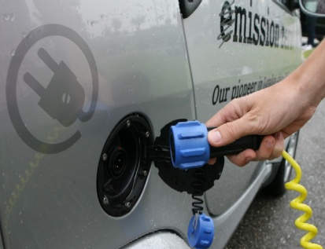
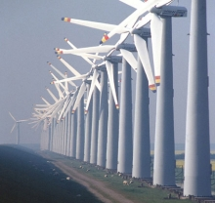
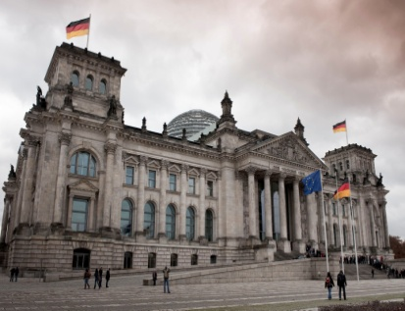
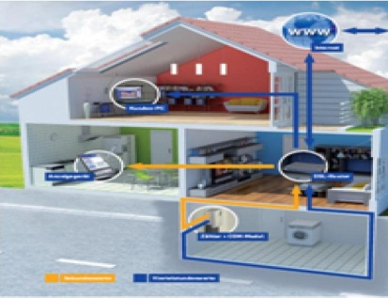
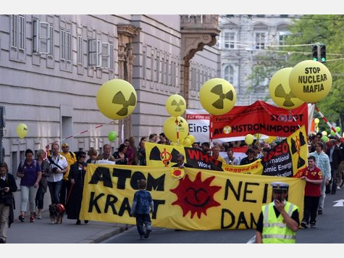
Overall objectives of the alliance
Investigating interfaces between energy supply and demand over a 5 year period during which considerable changes are envisioned
Analyzing the mutual relationships between the services provided by future energy supply systems and the services required by industrial or private users
Contributing to the understanding of society’s capability to initiate the necessary adaptation measures for new energy infrastructures
Designing adequate, reliable and promising transformation strategies
SEITE 11

Slide 12
The approach
Five pillars of the research strategy:
Socio-technical development
Innovation processes
Risks and Governance
User Behaviour (private and commercial)
Planning procedures (acceptance for infrastructures)

Slide 13
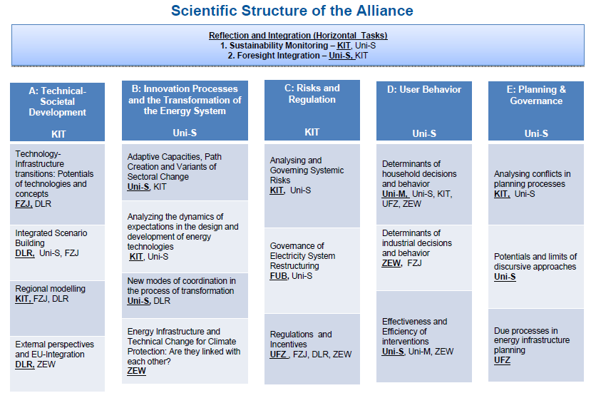

Slide 14

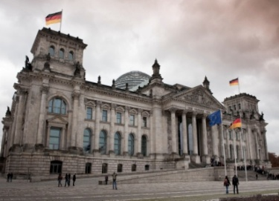

RF A: Technical-Societal Development
Motivation
New technological and organizational infrastructures will be needed to transform the German energy system
There is a need to assess the economic, environmental, and social impacts of energy related infrastructures
Objectives
Identifying the socio-technological potentials of key infrastructures
Developing consistent scenarios that connect feasible techno-economic developments to society’s expectations and preferences
Matching the results of regional analyses with national, European and international energy developments
SEITE 14

Slide 15
RF B: Innovation Processes and the Transformation of the Energy System
Motivation
Innovation is a central element of the transformation process
Successful innovation is the result of a complex interplay between individual and institutional actors
The projected change in centralization will challenge the established actor constellation along the innovation chain
Objectives
Gaining an improved understanding of transformation processes by investigating actor networks as well as innovation contexts
SEITE 15

Slide 16
RF C: Risks and Regulations
Motivation
Systemic character of energy supply and demand leads to the emergence of systemic risks as well as opportunities
Energy transformation is characterized by complex relationships between energy technology developers, energy suppliers, energy transport organizations and energy users.
Regulations such as incentives, legal provisions and planning instruments have a major impact on transformations
Objectives
Understanding and exploring the mechanisms of risk and opportunity governance for systemic risks
Exploring the significance of vertical and horizontal governance structures in Germany and Europe for facilitating transformations
SEITE 16

Slide 17
RF D: User Behavior
Motivation
Users will play a more significant role in the future energy system
The system will be more dynamic with private households becoming energy providers, cars storing energy, and smart meters making energy consumption visible and controllable
There is a lack of knowledge about the motivations of users to accept or support changes in behavior and about successful intervention strategies
Objectives
Exploring the potential for efficient energy use and energy saving
Understanding the determinants of energy consumption
Investigating the efficiency and effectiveness of interventions including feedback and social communication and their interactions
SEITE 17

Slide 18
RF E: Planning & Governance
Motivation
The envisioned energy transformation will require communities to adopt new measures for planning new infrastructures (high-voltage power lines, pump storage facilities, wind parks, CCS storage)
Public opposition and conflicts need to be addressed in a constructive and fair manner
New and participatory planning procedures are required as well as innovative approaches to conflict resolution
Objectives
Contributing to the theory and the practice of public participation
Exploring the potential for analytic-deliberative processes
Suggesting changes and innovations for the planning laws
SEITE 18

Slide 19

Horizontal Tasks
HT.1 Sustainability Monitoring
Developing relevant sustainability indicators
Applying them to the strategies, policies and scenarios with the purpose of guiding and monitoring the transformation processes in Germany
HT.2 Foresight Integration
Assessing and monitoring the progress made during the course of the ongoing foresight processes
integrating their major results
reflecting on the methodology used
scrutinizing the quality criteria that were used in the construction and validation of the scenarios
SEITE 19

Slide 20
Conclusive remarks
Energy transition is characterised by a high degree in complexity
This is reflected in the Alliance ENERGY-TRANS
Interdisciplinary research needed to guide a transition
Interdisciplinary needs learning and experience
Uncertainties need to be made explicit
TA provides tools and methods for such tasks
TA aims at producing “knowledge for action” - for more robust and societal accepted decisions

Slide 21
Thank you for your attention!

