Slide 1
The Method Toolbox for Technology Assessment: From Science to Dialogue
Dr. Danielle Bütschi
Swiss Center for Technology Assessment (TA-SWISS)
PACITA 1st Summer School, Liège
27 June 2012

Slide 2
Technology Assessment
A common understanding of mission and approach:
Study and evaluation of the consequences of existing, new or emerging technologies
Interdisciplinarity
Communication
… but, a variety of methods!
TA

Slide 3
The TA method toolbox
Many available TA methods
New methods are constantly developed
Methods may have different aims
Collect data
Provide knowledge
Make previsions about the future
Organize communication among stakeholders
Gain understanding of the structure of conflicts
Contribute to conflict resolution
Etc.

Slide 4
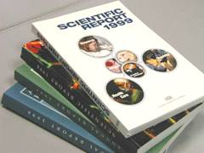
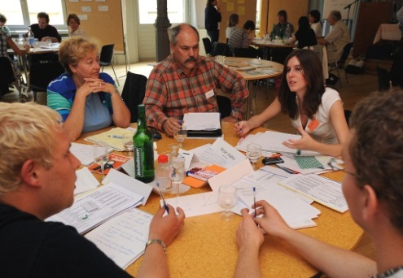
Three classes of TA methods
Scientific TA methods
Interactive TA methods
Communication TA methods

Slide 5
Scientific TA Methods
Mainly used for technology-driven issues to
Collect data and provide knowledge on science and technology developments, their impact (on economy, environment, health, etc.), the related ethical or juridical questions, the interests and values at stake, etc.
Quality criteria
Scientific quality criteria: objectivity, verification, reproduction
Interdisciplinarity
Examples of methods
Literature and database analysis, Delphi, modeling and simulation, discourse analysis, expert interviews.

Slide 6
Scientific methods - Delphi survey
Delphi is an iterative expert survey, which takes place in two or more rounds. In the second round or later, the experts receive a feedback of the first round.
Its design allows for an exchange of opinions among experts, without having to deal with the shortcuts of face-to-face settings (where those with prestige or talking loudly dominate)
The goal of a Delphi survey is to collect and synthesize opinions on an unknown future and to achieve a certain degree of convergence.
During the Delphi survey, experts have to give their opinion on statements related to the future.
Outputs are reports with tables, lists and figures - > suited for policy-makers.
Example: “Nanotechnology in medicine” (TA-SWISS, 2003)

Slide 7
Scientific methods - Scenario based analysis
A process of analyzing possible future events by considering several alternative future developments.
Scenario elaboration implies to
identify the factors that will have a strong influence.
Examine what range of outcomes these key factors could produce.
Synthetize the results in a limited number of scenarios (often an optimistic, a pessimistic and a most likely scenario).
Elaboration of scenarios often in collaboration with experts or stakeholders
Outcome helps decision-makers to define goals
Examples: “A Sustainable Danish Transport System”, DBT, 2011; “Future Perspectives of 2nd Generation Biofuels”, TA-SWISS, 2010

Slide 8
Interactive methods
Mainly used for problem-oriented issues for
Conflict management and resolution
Bringing together scientific expertise and citizens views
Involving stakeholders
Mobilizing citizens for shaping future technologies
Quality criteria
Inclusion
Procedural fairness
Transparency
Argumentative quality
Examples of methods
Consensus conferences, focus groups, expert hearings, scenario workshops

Slide 9
Interactive methods - Future workshop
Usually used at local level, with concerned citizens. For instance to assess local implementation of a technology or the way a technology related issue is being managed locally.
The purpose is to formulate concrete solutions and action proposals based on the participants’ own experience
Three phases process (lasting from a few hours to several days)
Critical analysis of the current situation
Elaboration of future visions
Formulation of action proposals
Output is a report with proposals for action. Actions can be either directed to policy-makers or be implemented by participants themselves.
Example: “Technological solutions for small communities”, DBT, 2002

Slide 10
Interactive methods - Consensus conference
During a consensus conference, a group of 30 citizens assess a technology-related issue that is socially controversial .
The purpose is to broaden the debate on a technology related issue and include the viewpoints of non-experts in order to inform policy-makers.
Laypeople put their questions and concerns to a panel of experts, assess the experts’ answers and then negotiate among themselves a consensus statement including their expectations, concerns and recommendation .
The output is a report written by the citizens. It is directed at parliamentarians, policy makers and the general public
Examples: “Testing our genes”, DBT, 2002; “Research on Human Beings”, 2003, TA-SWISS.

Slide 11
Consensus conferences revisited
The Consensus conference method is an expensive and time consuming method.
Many other methods are derived from the consensus conference method, in order to reduce the costs for both organizers and citizens (publifocus, world wide views, etc.)
The purpose is the same (include the viewpoints of citizens in order to inform policy-making), but the design is less resource demanding.
Consensus conferences, a model for participatory TA.

Slide 12
Interactive methods - Expert hearing
Policy-makers (e.g. members of Parliament) invite experts from different disciplines to give their input on a technology-related issue and to answer their questions.
The purpose of expert panels is to give the politicians the opportunity to find answers to a number of specific questions in relation to a current policy issue.
A parliamentary hearing lasts between a half and a whole day. They can be open to the public.
The output of the hearing is a report containing a summary, a complete transcript of the hearing and the written expert presentations.
Example: “Hearing on the Internationalisation of Education”, DBT, 2006

Slide 13
Communication methods
Communication methods may have several aims:
Communicate the corporate image of a TA institution and the TA approach
Disseminate the results of TA projects (e.g. a report)
Communicate about science and technology
Quality criteria:
Flexibility related to the ongoing debate
Political embedding
Target oriented form and content
Examples of methods:
Newsletter, opinion article, fact-sheet, résumé, science theater, press release, conference, etc.

Slide 14
Communicative methods - Science festival
One or more days event, involving scientists and artists.
Dedicated to a certain thematic
The “Glass Body” technology festival, Rathenau Institute, 2008
“The festival examined diverse modern phenomena such as supermarket loyalty cards, DNA analysis, security cameras and YouTube. The contributors included professor of criminal law Ybo Buruma, author Joep Schrijvers and poetry slammer Krijn Peter Hesselink.”

Slide 15
Communicative methods - Scientific café
A panel of 3-5 experts is invited to discuss a technological or scientific issue with the public.
The purpose of the scientific café is to achieve a sound and common understanding of a technology related issue.
The atmosphere should be one of a café, i.e. audience sitting at small tables (3-5 persons per table) and the discussions being informal. After a short round of presentation, the experts answer the audience’s questions.
A moderator is leading the discussions.
Examples:
“The vulnerability of the IT infrastructure”, DBT, 2003
“Internet and young people: Is it serious, doctor?”, TA-SWISS, 2011

Slide 16
How to pick the right method? - 1
The institutional setting will affect the kind of method used :
What is the mission of the TA organization? Is it a scientific institution or a policy advisory body?
Who are the addressees?
Which expertise is available within the institution? What is in the method toolbox of the TA institution?
What are the available resources?
What is the issue being assessed and what is the political and social context (framing)?
Technology-oriented issue vs problem-oriented issue?
What is the stage of the policy-making process? What is the intensity of the political debate?
To what extent is the issue discussed in society?
Is it conflictual?

Slide 17
How to pick-up the right method? - 2
What is the development stage of the technology under scrutiny?
Development stage (need to better understand what the technology is and its opportunities and risks, to discuss societal goals with respect to this emerging technology)
Existing technology (need to solve conflicts, to shape the technology, to reconsider a technology having regard to the present reality, etc.)
What kind of knowledge is available?
What about the quantity and quality of available knowledge?
Is there consensus among experts and scientists?
Are there “knowledge gaps”?

Slide 18
Methods in the service of TA
Doing TA is not about applying a given “TA method”, but to design TA projects using the appropriate method(s)
The TA method toolbox may vary from institution to institution.
The TA method toolbox can be filled with new and innovative tools.

Slide 19
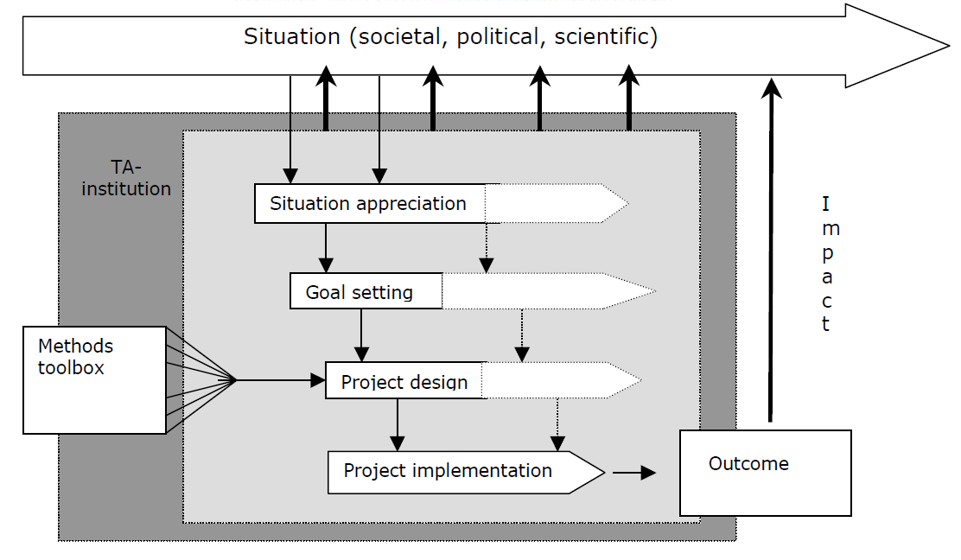
Project design: from method to impact
From: Decker and Ladikas (Eds), 2004. Bridges between Science, Society and Policy. Technology Assessment – Methods and Impacts, Springer.

Slide 20
Thank you for your interest!

