Slide 1
Communication Work and the Strive for Impact
Dr. ir. Jurgen Ganzevles
Rathenau Institute, The Netherlands
Liège, 27.06.2012

Slide 2
TA =

Slide 3
TA = Communication

Slide 4
TA = Communication

Slide 5
TA with Impact = Communication

Slide 6
TA with Impact = Communication²

Slide 7


TA = Communication
Prof. Dr. Ir. Ing. Mrs. Drs. PhD. MSc. MA. Mr. MBA

Slide 8

TA = Communication
Communication Officer
Prof. Dr. Ir. Ing. Mrs. Drs. PhD. MSc. MA. Mr. MBA

Slide 9
TA = Communication
Communication Officer
Interesting… but what’s the message?
Prof. Dr. Ir. Ing. Mrs. Drs. PhD. MSc. MA. Mr. MBA

Slide 10
TA = Communication
?
Communication Officer
Interesting… but what’s the message?
Prof. Dr. Ir. Ing. Mrs. Drs. PhD. MSc. MA. Mr. MBA

Slide 11
TA = Communication
Turning sophisticated research into plain messages
Get your message across

Slide 12
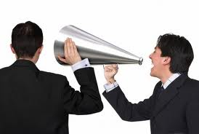
TA = Communication
Turning research into messages
Send them out

Slide 13
TA = Communication
Get your message received
Find the audience
Complexity comes in

Slide 14
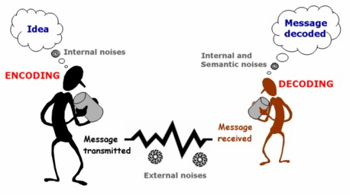
TA = Communication
Get your message received
Find the audience
Complexity comes in…

Slide 15
TA = Communication
STILL ONE MEDIUM,
ONE DIRECTION

Slide 16
TA with Impact = Communication²

Slide 17
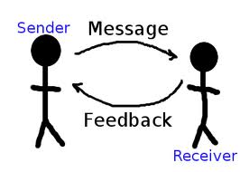
TA with Impact = Communication²

Slide 18

TA with Impact = Communication²

Slide 19
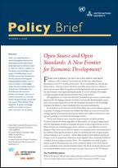
TA with Impact = Communication²

Slide 20
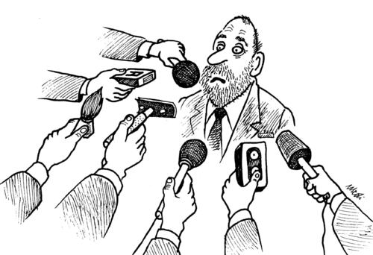
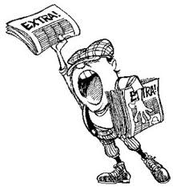
TA with Impact = Communication²

Slide 21
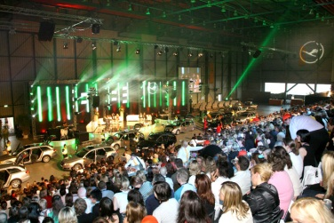

TA with Impact = Communication²

Slide 22

TA with Impact = Communication²

Slide 23
TA with Impact = Communication²
MONITOR
FEEDBACK

Slide 24
TA with Impact = Communication²
HELP!

Slide 25
TA with Impact = Communication²
STRATEGY NEEDED

Slide 26
Designing a TA communication strategy: challenging
Multiple audiences
Multiple messages
Multiple events
Politically sensitive material
Limited time to make research robust: fast ‘message creation’
Additional in-house communication expertise needed

Slide 27
Designing a TA communication strategy: challenging
Project plan
Project activities
Project results
Communication of results

Slide 28
Designing a TA communication strategy: challenging
Project plan
Project activities
Project results
Communication of results

Slide 29
Designing a TA communication strategy: challenging
Project plan
Project activities
Project results
Communication of ideas, plans, events, interim results and results

Slide 30
TA with Impact = Communication²
COMMUNICATION =
PROFESSIONAL DESIGN

Slide 31



Communication Design at the Dutch Rathenau Institute
Tasks:
  Stimulate political opinion forming on S & T
  Stimulate societal debate on S & T
  Study the science system
Formal clientele:
  Parliament (both chambers + European)
  Government: Dutch Cabinet
  Society at large
Four departments
  Technology Assessment (21 persons)
  Science System Assesment (22 persons)
  Communication (8 persons)
  Administrative and support (12 persons)
Annual budget: around 4 million euros

Slide 32
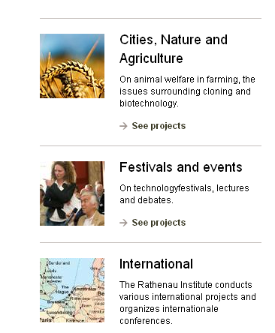
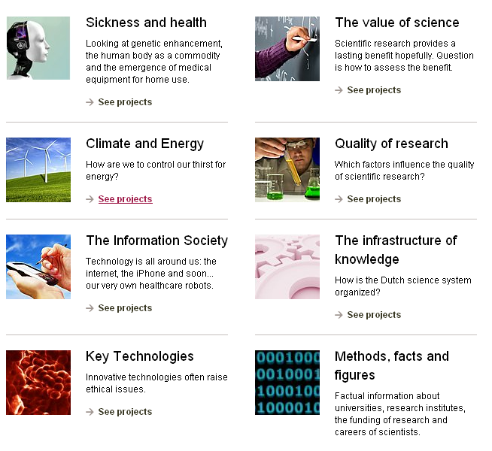
Broad range of themes and activities

Slide 33
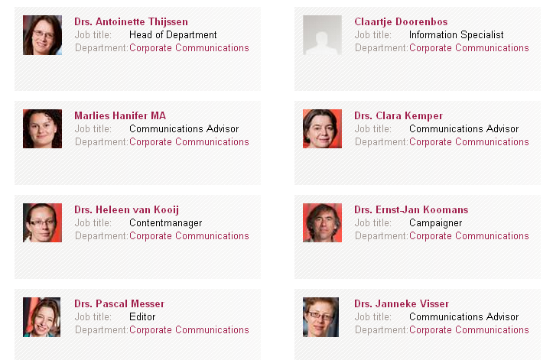
Communication Department at the
Rathenau Institute

Slide 34
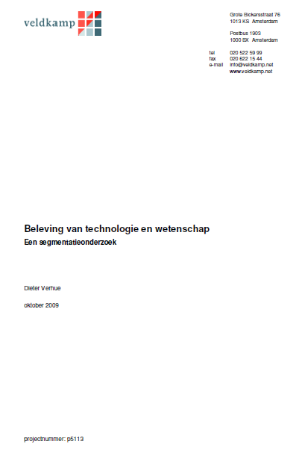
Designing Communication: an Elementary Model

Slide 35
An Elementary Communication Model
much progress
little progress

Slide 36
An Elementary Communication Model
much progress
much regulation
little regulation
little progress

Slide 37
An Elementary Communication Model
much progress
Ambassadors
much regulation
little regulation
little progress

Slide 38
An Elementary Communication Model
much progress
Ambassadors
much regulation
little regulation
Concerned
little progress

Slide 39
An Elementary Communication Model
much progress
Functionalists
Ambassadors
much regulation
little regulation
Concerned
little progress

Slide 40
An Elementary Communication Model
much progress
Functionalists
Ambassadors
much regulation
little regulation
Concerned
Skeptics
little progress

Slide 41
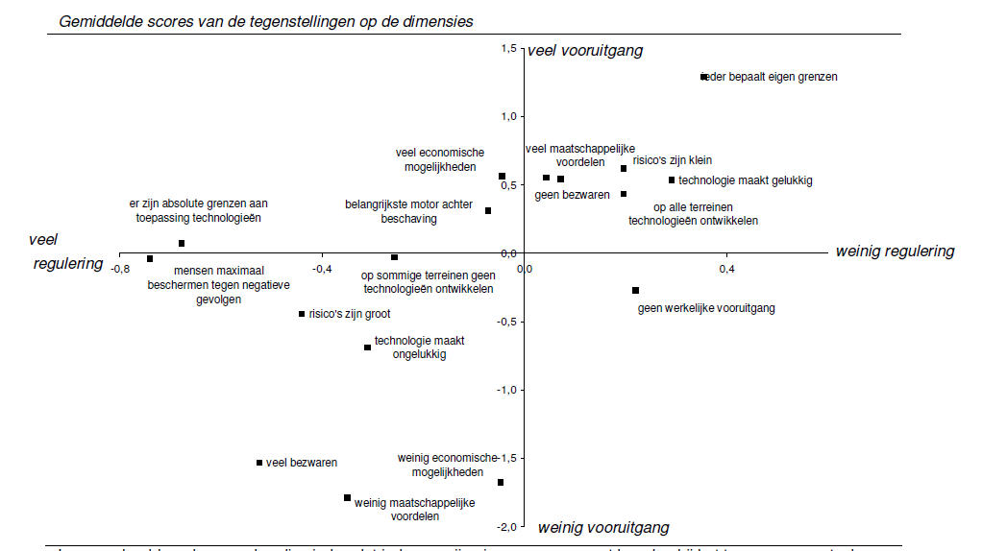
An Elementary Communication Model

Slide 42
An Elementary Communication Model
Functionalists
much progress
Ambassadors
Relevance for solving societal problems
Reduce resistance with other segments
much regulation
little regulation
Ethical
issues
Relevance for personal life
Concerned
Skeptics
little progress

Slide 43
An Elementary Communication Model
ADDRESS DIFFERENT TARGET GROUPS… DIFFERENTLY!
Functionalists
much progress
Ambassadors
Relevance for solving societal problems
Reduce resistance with other segments
much regulation
little regulation
Ethical
issues
Relevance for personal life
Concerned
Skeptics
little progress

Slide 44
An Elementary Communication Model
PACITA Task 2.1
Describing existing practices of Parliamentary TA in Europe

Slide 45
An Alternative Communication Model

Slide 46
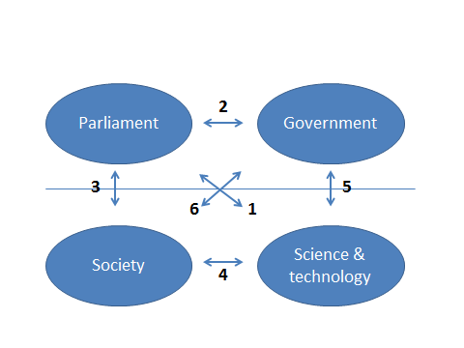
An Elementary Communication Model

Slide 47
An Elementary Communication Model
INSTITUTIONAL SETTING MATTERS

Slide 48
An Elementary Communication Model
ADDRESS DIFFERENT TARGET GROUPS… DIFFERENTLY!

Slide 49
Communication Work: Relating Products to Impact
Products
  Reports & books
  Policy Briefs
  Documentaries
Targeted approaching
  Parliamentary expert meetings
  Knowledge Chambers at ministries
  Presentations before researchers and stakeholders
Broad campaigning
  Launching event
  Opinion articles
  Radio and television

Slide 50
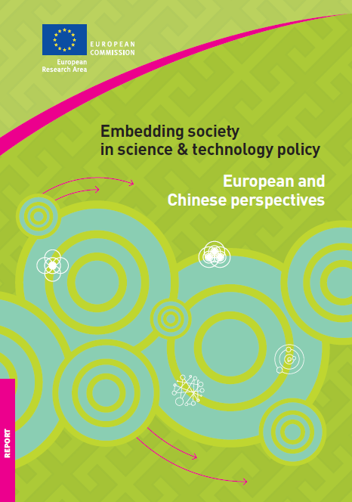
A Theoretical Impact Model
http://ec.europa.eu/research/science-society/document_library/pdf_06/european-and-chinese-perspectives_en.pdf

Slide 51
Communication work: from informing to calling for political action
Background information
Sketching out policy options
Calling upon politicians to act
Informational legitimicy
Procedural legitimicy
Legitimicy framed in the text
TA staffers as ‘public intellectuals’ (ref. W. Bijker)
Substantial training & coaching
Q & A sessions

Slide 52
Communication work: from project to campaign
Evidence based reports
Citizen participation and public discourse
In function of the political realm;
agenda, recommendations and communication
Professional attitude towards media attention
From project to campaign

Slide 53

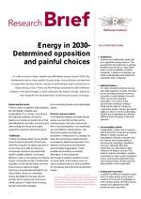
Illustrations from the ‘Energy in 2030’ Project

Slide 54
Foundations built up in the ‘Energy in 2030’ Project

Slide 55
Foundations built up in the ‘Energy in 2030’ Project
Launching event
Expert meetings
Illustrations
Essays
Interviews

Slide 56
Foundations built up in the ‘Energy in 2030’ Project

Slide 57
Foundations built up in the ‘Energy in 2030’ Project
KILL YOUR DARLINGS

Slide 58
Foundations built up in the ‘Energy in 2030’ Project
KILL YOUR DARLINGS
SAY SOMETHING NEW

Slide 59
Foundations built up in the ‘Energy in 2030’ Project
KILL YOUR DARLINGS
SAY SOMETHING NEW
SAY STH. CONTESTWORTHY

Slide 60
Foundations built up in the ‘Energy in 2030’ Project
KILL YOUR DARLINGS
SAY SOMETHING NEW
SAY STH. CONTESTWORTHY
DON’T FEAR CONTROVERSY

Slide 61
Foundations built up in the ‘Energy in 2030’ Project
KILL YOUR DARLINGS
SAY SOMETHING NEW
SAY STH. CONTESTWORTHY
DON’T FEAR CONTROVERSY
STEP BESIDE THE PRODUCT

Slide 62
Foundations built up in the ‘Energy in 2030’ Project
KILL YOUR DARLINGS
SAY SOMETHING NEW
SAY STH. CONTESTWORTHY
DON’T FEAR CONTROVERSY
STEP BESIDE THE PRODUCT
ENGAGE IN THE DEBATE

Slide 63
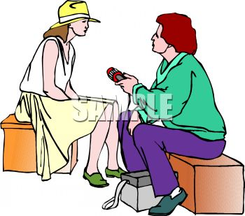
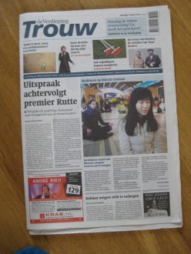
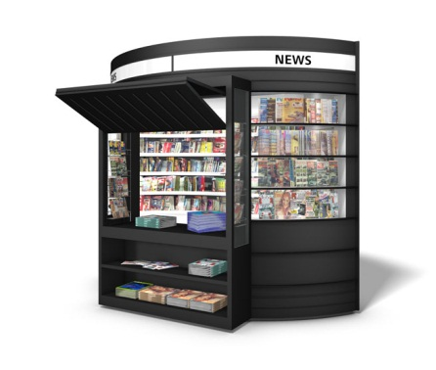
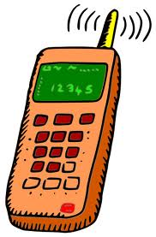
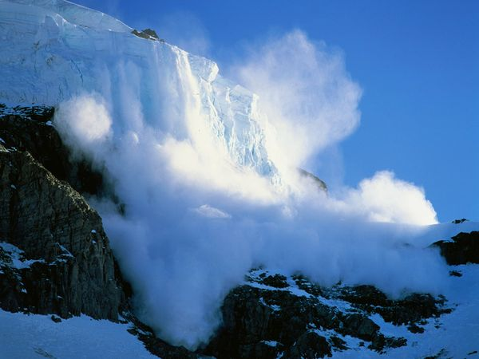
Early media avalanche: stepping out is no option

Slide 64
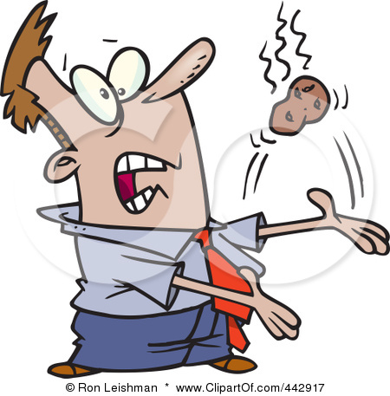
Interview requests as a “hot potato”
director
head of department
coordinator
project leader (me!)

Slide 65

Illustrations from the ‘Energy in 2030’ Project
television
symposium
newspapers
‘Twittering’ MPs
first edition for director-general Energy
magazine
reference in parliament
radio

Slide 66
Messages from the ‘Energy in 2030’ Project..
The energy discourse is dominated by 7 energy myths
The national energy economy gets more dirty, less reliable and less profitable
Societal support for energy policy is a major challenge
More transparancy & rulemaking necessary
… appeal differently to different media

Slide 67
Lessons learned
Be patient: sound research is always important
Be prepared: timely training & no pub crawl ‘the night before’
Be available: attention wave lasts
Multiply availability (are collegues willing & prepared?)
Hold on: attention wave will go down
Media attention is not the holy grail
  It helps to get political attention and increase public awareness, but is not equal to political decision making: gap between ‘clear’ media messages and specificity of energy dossiers & nuts and bolds of lawmaking (downside of campaigning model).

Slide 68
Concluding Remark
TA with Impact = Communication²

