Slide 1
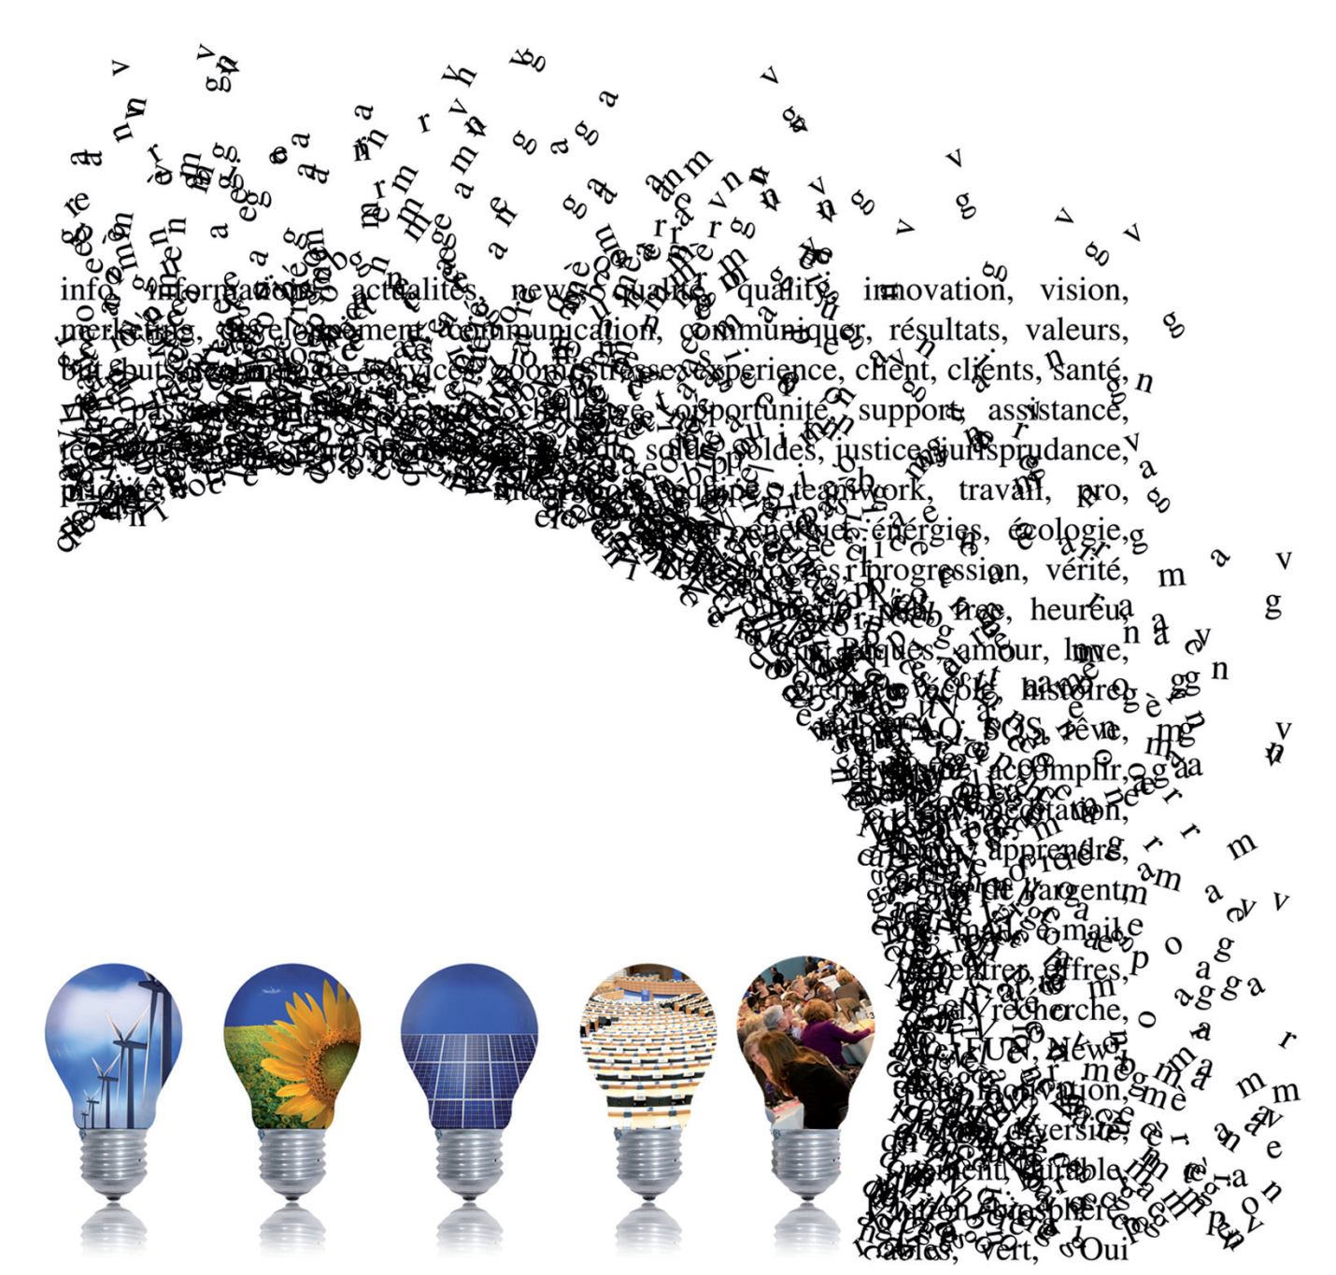
Concluding Remarks from a Non-PTA Country: Insights and Future Directions Dr Paidi O’Reilly, University College Cork Château de Colonster - University of Liège, Belgium 28th June, 2012

Slide 2
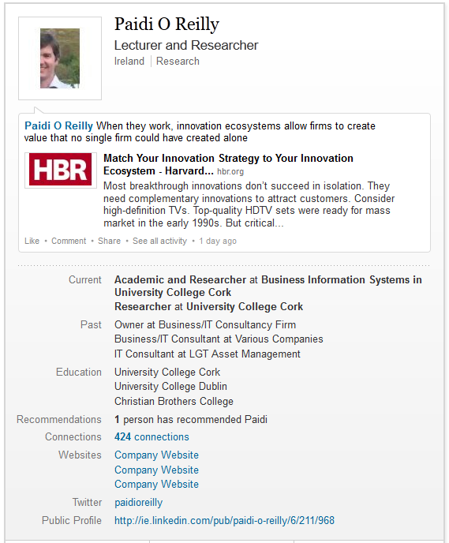
About me and about UCC

Slide 3
A brief summary and critique…

Slide 4
What is Technology Assessment? … [1]
What is Technology Assessment (TA)?
It is a scientific, interactive and communicative process which aims to contribute to the formation of public and political opinion on societal aspects of science and technology (Decker & Ladikas, 2004)
It involves the study and evaluation of existing, new and emerging technology and science by taking into account the interface of these with society
It is an interdisciplinary and dynamic approach to addressing existing and potential problems and preventing potential damage
It provides a neutral and objective input for decision making and policy making
It may take the form of early warning TA, parliamentary TA, constructive TA, discursive or argumentative TA
Parliamentary TA is where parliament is the main client of the TA activity
It may focus on diverse themes such as … energy, health, aging, etc.
It may involve experts, stakeholders, and possibly citizens …

Slide 5
What are the TA methods? ... [2]
There are many available TA methods and new ones are constantly being developed
TA Method categories include Scientific or Expert TA, Interactive or Participatory TA, and Communication TA.
The TA methods have different aims, including collecting data, providing knowledge, making provisions about the future, communicating among stakeholders, gaining understanding of the structure of conflicts, contributing to conflict resolution, etc.

Slide 6
What are TA impacts? [3]

Slide 7
Some points of reflection…

Slide 8
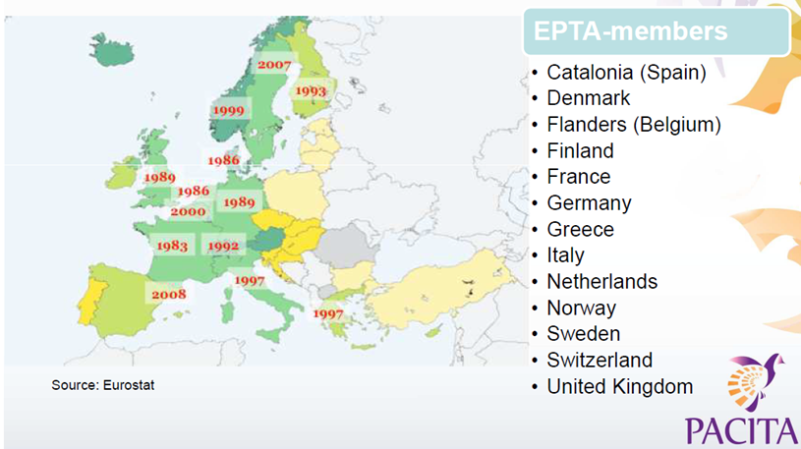
The European PTA landscape

Slide 9
A deficit in European Technology Assessment? …

Slide 10
Reflection: The existence of a technology assessment institution in a country/region is related to the ‘mindfulness’ of that geographical area.

Slide 11
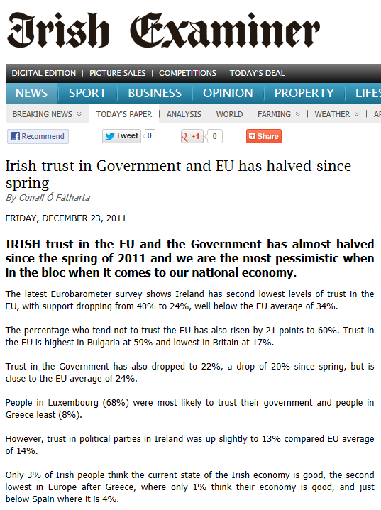
Part of a larger democratic problem

Slide 12
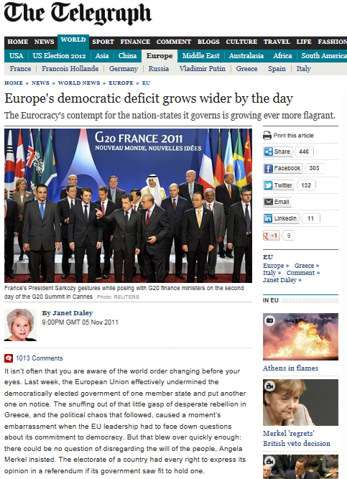
The ‘Democratic Deficit’ is not isolated but widespread

Slide 13
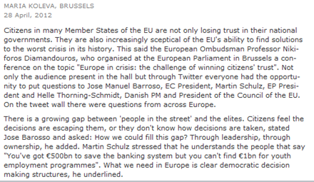
This is acknowledged at the highest levels

Slide 14
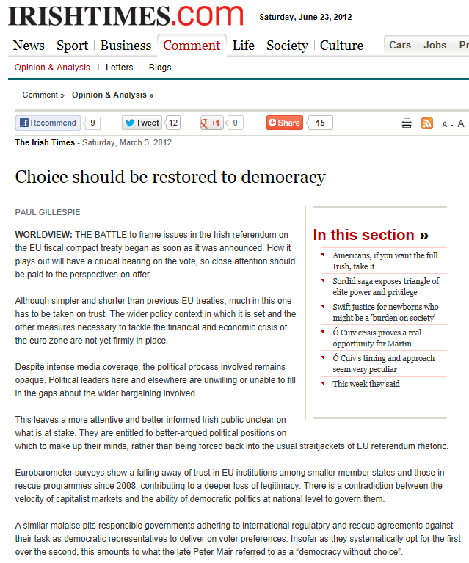
Choice needs to be returned to the citizens

Slide 15
Reflection: In order to be successful Technology Assessment must assist in closing the democratic deficit rather than maintaining or increasing it.

Slide 16
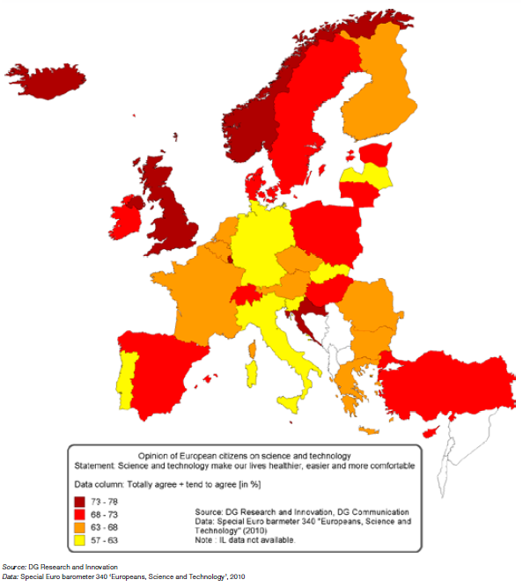
EU citizens are largely supportive of science and technology

Slide 17
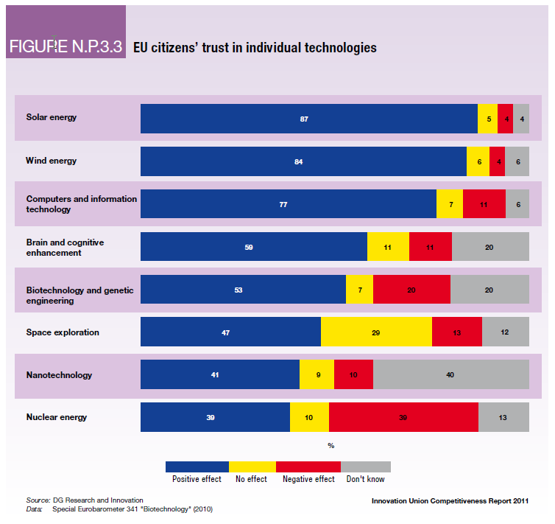
EU citizens’ support for individual technologies

Slide 18
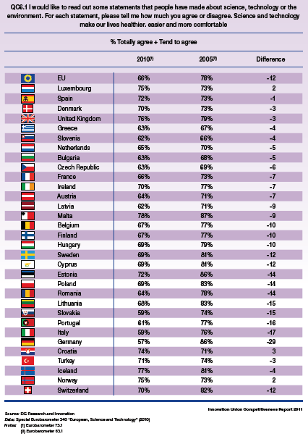
But this support is not without limits

Slide 19
Reflection: In order to be successful Technology Assessment must respect and not abuse the trust of EU citizens in science and technology.

Slide 20
Many stakeholders with many perspectives

Slide 21
Reflection: In order to be successful Technology Assessment must be inclusive of increasingly complex networks of stakeholders.

Slide 22
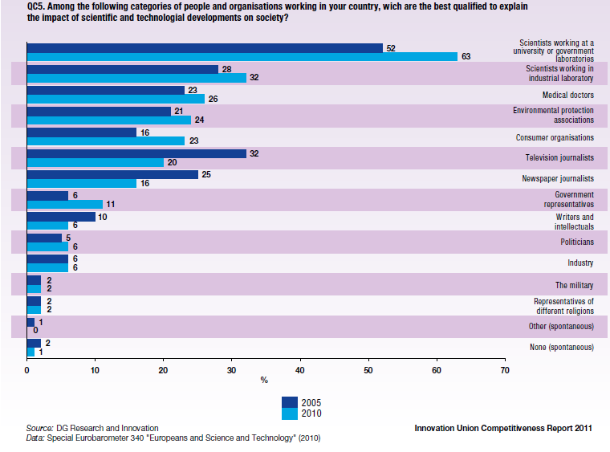
EU citizens trust in the ability of scientists to explain the impact of science and technology

Slide 23
Reflection: In order to be successful Technology Assessment must build trust between stakeholders

Slide 24
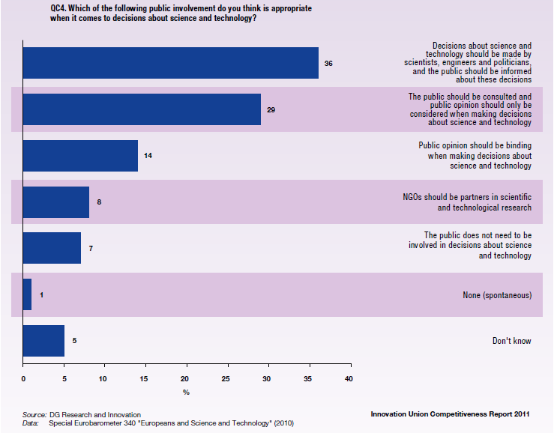
EU citizens wish to be involved in decisions about science and technology…

Slide 25
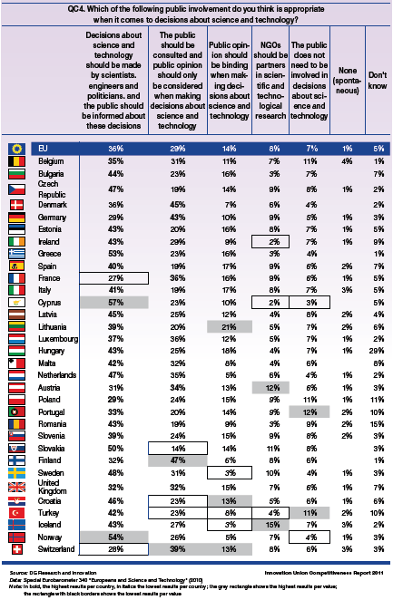
This desire varies by country

Slide 26
Reflection: EU citizens do have a desire to be involved in Technology Assessment

Slide 27
A perspective … my perspective?

Slide 28
Technology Assessment is a social construction ...
In addition to a plurality of views on what TA is, there is also a plurality of perspectives on the role of science and technology in society.
TA involves the social construction of the meaning and value of a technology or science in a given context.
We are all involved in this process ... as are all other stakeholder groups.
This social construction depends on many perspectives with the result there is no objective assessment of value.
So TA takes place even in the absence of the institutionalisation of TA i.e. TA does not depend on the existence of a TA institution.

Slide 29
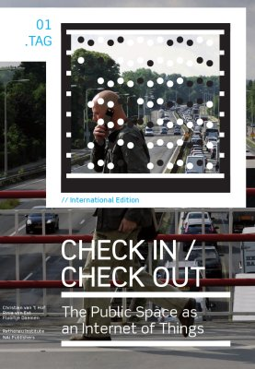
Technology Assessment involves messy problems
TA is a messy problem involving many different stakeholders with many different views …
In such cases rational decision making can play only a limited role.
Instead the focus ought to change to designing options rather than selecting between options.
We need to consider science, technology, society, economy, politics in tandem and not separately
“As our information society is entering a new phase, we no longer surf on the net, we live in the net. While we are travelling, working and shopping, we continuously check in and check out. These digital transactions show governments and companies where we are and what we are doing. We have become moving dots on a digital map. In exchange for this loss of privacy, we get access to information, spaces and goods. But what are the risks? And what price will we pay?”
An Example?

Slide 30
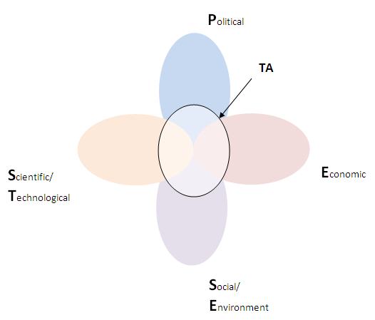
A Perspective on Technology Assessment

Slide 31
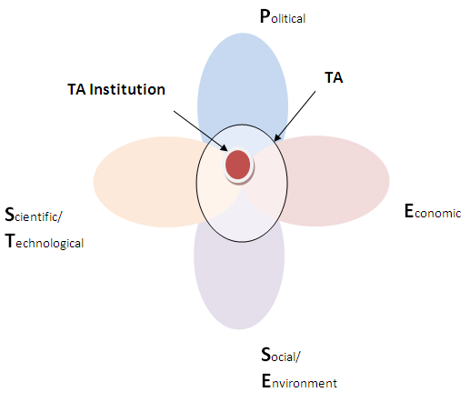
A Perspective on Technology Assessment

Slide 32
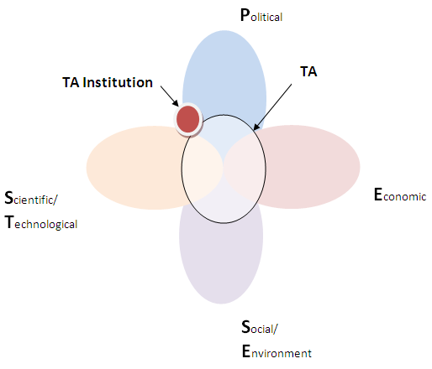
A Perspective on Technology Assessment

Slide 33
If outside can TA institutions answer the Questions central to Technology Assessment (Van Est & Brom, 2012)
Technology development
technological trajectory – past, current, and future, alternative technological options
Relevant social actors
actors (individuals, groups or organizations involved in the development, implementation, and use of the technology
Potential social impacts
nature of and seriousness of potential positive and negative legal, economical, ecological, societal and cultural effects
Potential solutions
nature of and acceptability and side effects of policy options or instruments available to address various policy issues

Slide 34
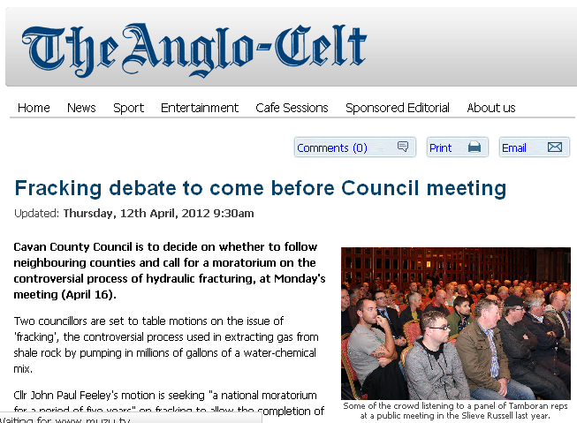
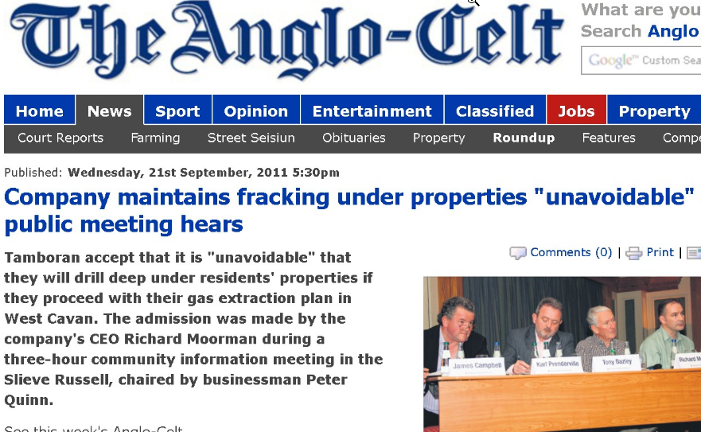
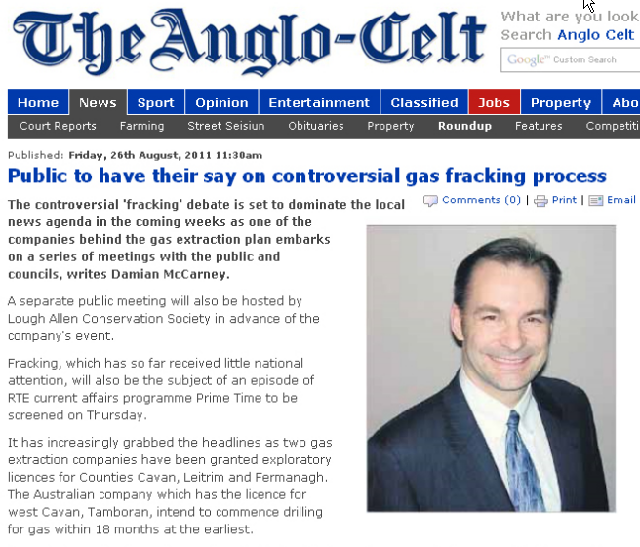
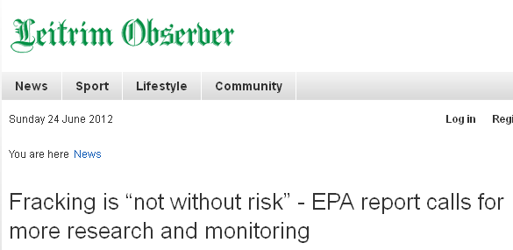
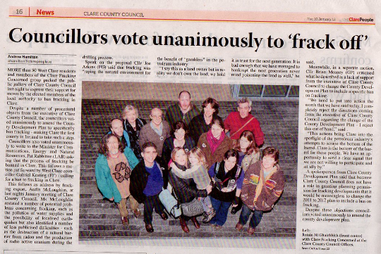
An anecdote from a European country …
The hydraulic fracking debate and the role of TA institutions …

Slide 35
An anecdote from a European country …

Slide 36
The BIG Questions
Prof Catherine Fallon suggested that ‘TA is a field on the move” but the question is to where and even more important to where should it go?
Given the diversity in European TA practices and recent austerity measures …
What are the TA models that will support us in Europe into the future?
What is the ‘business case’ for the institutionalisation of such a TA model?
Is the case sufficiently strong to justify investment in TA at the perceived expense to (say) front-line education, health, etc. And how can we overcome the ‘not now’ problem.

Slide 37
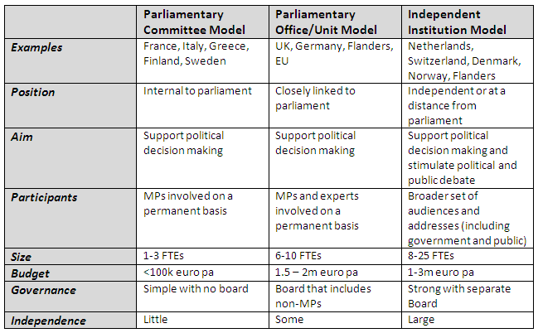
Question – Will models such as these suffice in the future for non-PTA countries?
Overview of existing PTA practices in Europe, Enzing et al, Conference on pan-European Parliamentary Technology Assessment – pEPTA, 2011

Slide 38
My perspective …
Knowledge production versus knowledge translation …
 | Problem/ Technology | Impact | Solution
Political
Economic
Social
Technology
Movement towards …
Shared understanding/ Shared commitment
Insights
Experts
Stakeholders
Citizens
Experts
Stakeholders
Citizens

Slide 39
The BIG Answers
Sorry out of time ... If you really want the answers come to the PACITA Summer School in Ireland, 2014! All are invited and all are most welcome.

Slide 40
Many Thanks Questions p.oreilly@ucc.ie

Slide 41
Facts … in summary …
Among European citizens there is a widespread agreement that science and technology make our lives healthier, easier and more comfortable.
However, since 2005 the share of Europeans experiencing a general trust in science has declined from 78% to 66%.
European citizens feel that decisions about science and technology should be made in dialogue with them by scientists, engineers and politicians, and the public should be informed about these decisions.
An important minority (29 %) wants a more participatory approach in which the public is consulted and taken into account when decisions are needed. The third minority of citizens by size (14 %) consider public opinion’s approval as a necessary condition for any decisions on science and technology.
The majority of European citizens – 63% of respondents at the EU-27 average in 2010 (an increase of 11 points since 2005) – agree that scientists working at a university or government laboratories are best qualified to explain scientific and technological developments
The trust in newspaper journalists has diminished from 25% in 2005 to 16% in 2010, and television journalists likewise are seen as less trustworthy, declining from 32% in 2005 to 20% in 2010, while the perceived quality of information from consumer organisations has increased from 16% in 2005 to 23% in 2010.

Slide 42
Facts … in summary …
Citizens in Finland, Denmark and Germany are relatively more in favour of increased use of public consultation on science and technology decisions
In some European countries respondents are more in favour of the second statement : in Finland at 47 %, Denmark at 45 % and Germany at 43 % respondents are more in favour of more consultations with the public about science issues. There are four countries where half or more of respondents agree that decisions about science and technology should be made by scientists, engineers and politicians, and the public should be informed about these decisions, with Cyprus at 57 % of respondents, Norway at 54 % of respondents, Greece at 53 % of respondents and Slovakia at 50 % of respondents.

Slide 43
Differences in Models ... [8]
Overview of existing PTA practices in Europe, Enzing et al, Conference on pan-European Parliamentary Technology Assessment – pEPTA, 2011

